Slide 1

OVERVIEW OF GRDM FIRES
IMESA
16-11-2018

Slide 2
Garden Route District Municipality, the leading, enabling and inclusive district, characterised by equitable and sustainable development, high quality of life and equal opportunities for all.

Slide 3
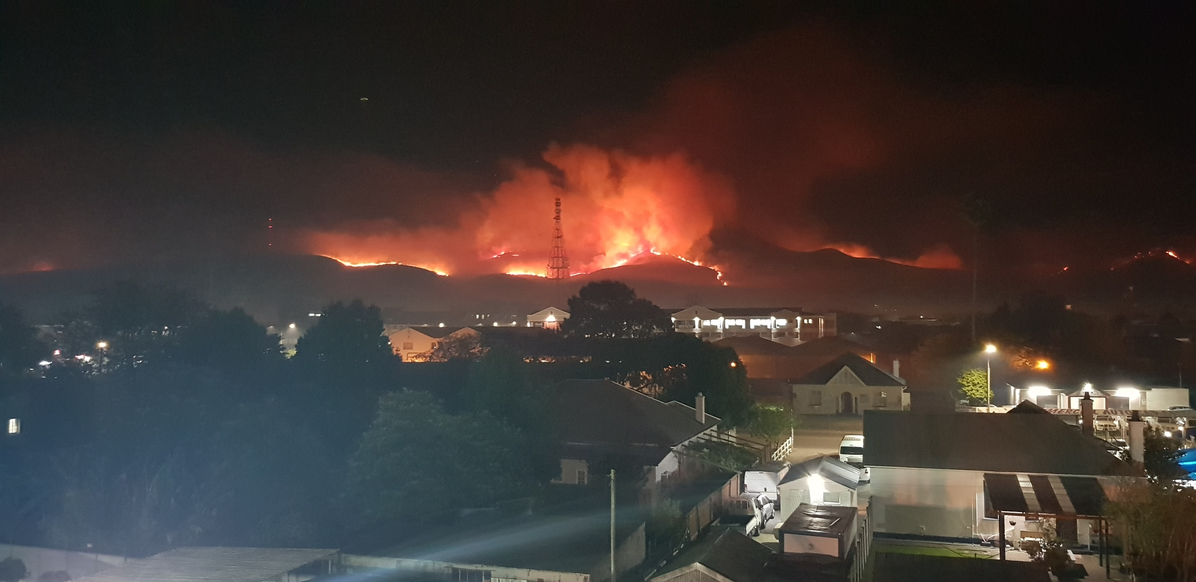
Headline
Text
www.gardenroute.gov.za

Slide 4
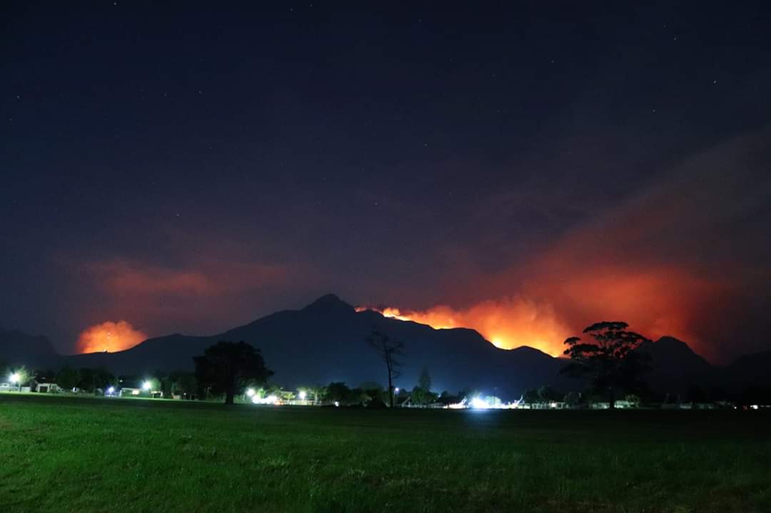
Headline
www.gardenroute.gov.za

Slide 5
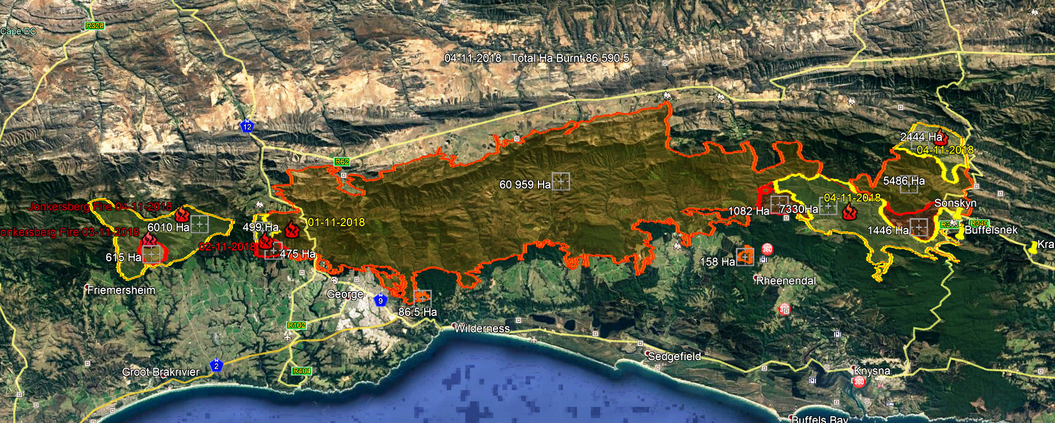

Slide 6
GARDEN ROUTE FIRES SUMMARY
Lives lost :
1 at the Vermaaklikheid fire (Pilot)
8 at the Karatara fire
no lives lost at the Harold – George fire
Excluding the Hessequa fires the total burnt area exceeds 91 000 Ha
(Knysna fires was 22 000 Ha - 4 x bigger area);
Houses lost or completely destroyed 38 (Most of these on San Parks and MTO property);
Total number of people evacuated over this period of time +/- 1000 people;
- From Farleigh to Pine Lake Marina (180);
- Geelhoutvlei Timbers staff housed at Tsiba hall at Karatara (25);
Fire fighters available to be used in shifts 579 , based at Rosemore base camp;
Aerial resources : WOF -Huey helicopters (3), Spotter planes (6), Air tractor bombers (3)
SANDF Oryx (2)

Slide 7
HIGH LEVEL OVERVIEW
The Garden Route Emergency Call Centre was informed of a fire at Vermaaklikheid on Sunday the 21st of October, crew based at Riversdale were the first to respond to assist Hessequa LM firefighters at this fire;
An FCP was activated at the New Apostolic church in Vermaaklikheid from where Unified fire command activities could be co-ordinated;
On Tuesday 23 October the tragic accident of Mr. Nico Heyns in one of the WOF Huey helicopters happened, this as well as the threat of the fire to the Vermaaklikheid community triggered the call for additional assistance. The closest aerial support was in Nelspruit as well as at Ugie in the Eastern Cape;
The PDMC was requested to inoke the Mutual Aid Assistance agreements of the Province. The Fire Chief as well as teams from the Overberg District Municipality were called upon to assist teams at Vermaaklikheid;
On Wednesday 24 October the GRDM was informed of a fire at Harold, all the available personnel and teams were still busy securing the fire at Vermaaklikheid therefore the George Local Municipality and a team form Cape Nature set up a FCP at Harold, this was moved to Denneoord air base the following day to co-ordinate fire fighting activities on this fire.
Initially this fire was high in the mountains in dense and very old vegetation hampering effective firefighting.
On Saturday the unified command structure moved to Witfontein Cape Nature reserve as the space at the Denneoord was limited;

Slide 8
HIGH LEVEL OVERVIEW (Cont.)
On Friday 26 October 2018 the Garden Route Fire Chief joined the Unified command structure to co-ordinate firefighting activities;
As soon as conditions at Vermaaklikheid were favorable, aerial resources were released to assist at the Harold Fire, but due to poor visibility aerial resources could not be utilized at crucial stages of the fire;
On Sunday 28 October both the PDMC as well as the Garden Route Disaster Centres were activated to set a co-ordination platform for co-ordination of all activities related to this fire;
Sunday evening the George Local Municipality opted not to activate their own JOC, but to join the District JOC in order to avoid duplication and to streamline lines of communication;
All the relevant National, Provincial as well as local role players were invited to a planning meeting on Sunday afternoon at 15:00, the focus of this meeting was to set a clear plan of action in terms of evacuation of areas threatened by the fire approaching George;
Since Sunday 28 October daily disaster co-ordination meetings as well as 24/7 presence at the fire IMT have been in place;

Slide 9
CHALLENGES
The vast area to be covered. The fire line of the Jonkersberg- Knysna fire is in in excess of 456 km (North and South +/- 200 Km, West and East +/- 25 Km);
Currently more than 17 two-way repeater sites have been lost in this fire, this has been a major stumbling block as for long periods of time area command did not have communication and feedback from fire lines;
The current drought conditions linked with the ever changing wind direction has lead to sporadic flare-ups making it difficult to bring the fire under control;
The limitations of aerial resources, when needed most, poor visibility made this resource redundant;
During the current drought conditions the indigenous forest can no longer be seen as a natural barrier to prevent the spread of wildfire, especially not when you experience wind speed in excess of 100 km/h;
Persons evacuated from areas returning to areas too soon;

Slide 10
MATTERS OF CONCERN
Geelhoutvlei Timbers Sawmill, arsenic polluted smoke ? About 473 people now without a work;
Hazardous waste material management;
Beervlei and Farleigh community housing project ?
Soil erosion and potential for landslides next to major roads;
Removal of burnt trees in road reserves (widow makers);
Management of access to burnt areas – (landowners to take responsibility)
The state of both privately owned land and DAFF property – poor housekeeping, overgrown with invasive alien plants ;
Invasive alien plants pose an ongoing threat in terms of fire in this region, to address this we need to combine efforts;
The time it takes to secure Disaster Rehabilitation and Reconstruction funding especially to address environmental infrastructure (Knysna Fires took 15 months), if we do not act now the area will have an even bigger fire risk in the next 10 years,
The lack of a defendable space around properties, especially in the wildland urban interphase – no properties lost in George mainly due to fire beaks implemented since July last year;

Slide 11
WAY FORWARD
Spatial planning and building codes for the development of urban interphase areas should be reconsidered;
Enforcement of local buy-laws in terms of high fire hazard areas, especially in urban fringe areas;
To improve public awareness in order to create fire wise communities;
Integrated veld fire management needs to be prioritised;
Disaster Risk Reduction funding needs to be addressed;

Slide 12
WORK GROUPS/TASK TEAMS ESTABLISHED
Humanitarian work stream - Convener Me Marie Hendricks Cell: 082 941 1082
Marie.Hendricks@westerncape.gov.za;
Environmental work stream – Convener Mr. Paul Buchholz Cell:0798814447
p.huchholz@outlook.com;
Human Settlements - Convener Mr. Bosco Khoza Cell: 0791895522
Bosco.khoza@thehda.co.za;
Finance - Convener Mr. Monde Stratu Cell:0835791075
mm@gardenroute.gov.za;
Tourism and LED - Convener Me. Melanie Wilson Cell: 0828055285
melanie@gardenroute.gov.za;
Infrastructure - Convener Mr. Xander Smuts Cell: 0760362805
Xander.smuts@westerncape.gov.za;
AGRI -Convener Mr.Hannes Muller Cell: 0829081113
hannesm@elsenburg.com
Disaster Risk Reduction - Convener Mr. Gerhard Otto Cell: 0814699128
gotto@gardenroute.gov.za

Slide 13
ORGANISATIONS ASSISTING THE GRDM AND THE IMT
PDMC (IMT and Disaster Management support)
WOF (IMT and Fire fighting)
SANDF (Air support)
Cape Nature (IMT and firefighting support)
San Parks (IMT and firefighting support)
George Local Municipality (Part of the IMT / co-ordination of evacuations/ base camp/ donation management)
Knysna Municipality (Part of the IMT)
Fire fighting assistance ( George, Oudtshoorn, Knysna, Bitou, Hessequa, Mossel Bay, Kannaland,)
District Municipalities ( Overberg, Winelands, West Coast )
City of Cape Town (Fire fighters and IMT support)
Various NGO’s and FBO’s (Lions, Gift of the Givers etc.)
SPCA;
The people of George and surrounding areas;

Slide 14
ORGANISATIONS ASSISTING THE GRDM AND THE IMT (Cont.)
National and Provincial Departments
Department of Health,
EMS,
Human settlements,
Rural Development,
Housing Development Agency,
Department of Agriculture,
Department of Education,
SASSA,
DSD,
ESKOM,
Department of Transport,
Provincial Traffic,
SAPS,

Slide 15
TAKE HOME MESSAGE FOR ENGINEERS
Do you know what is expected from you and your Department during mass evacuations?
Have you identified disaster scenario egress routes?
Have you informed your Fire Chief of your critical installations to be prioritised during fire response planning?
What steps have you taken to “fire proof” your critical installations?
During a veldt fire, would you staff be safe at your critical installations, especially those on the urban fringe?
Do you have a defendable space around your critical installations, where do you store your chlorine?
If this is the new norm, what would you be including into your by-laws in terms of WUI development?

Slide 16
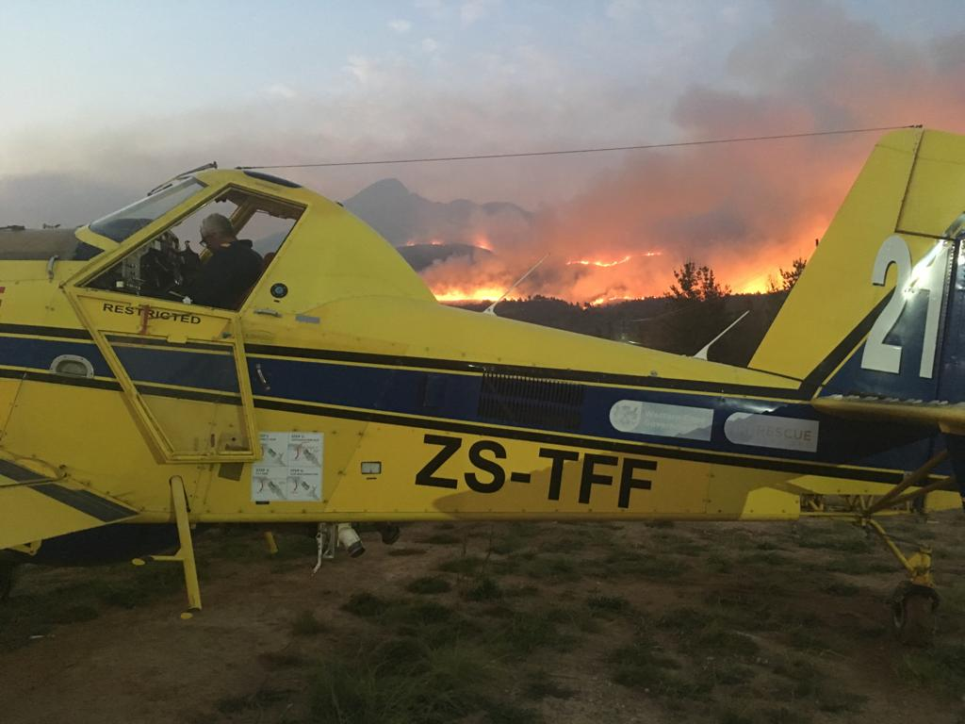
Response
www.gardenroute.gov.za

Slide 17
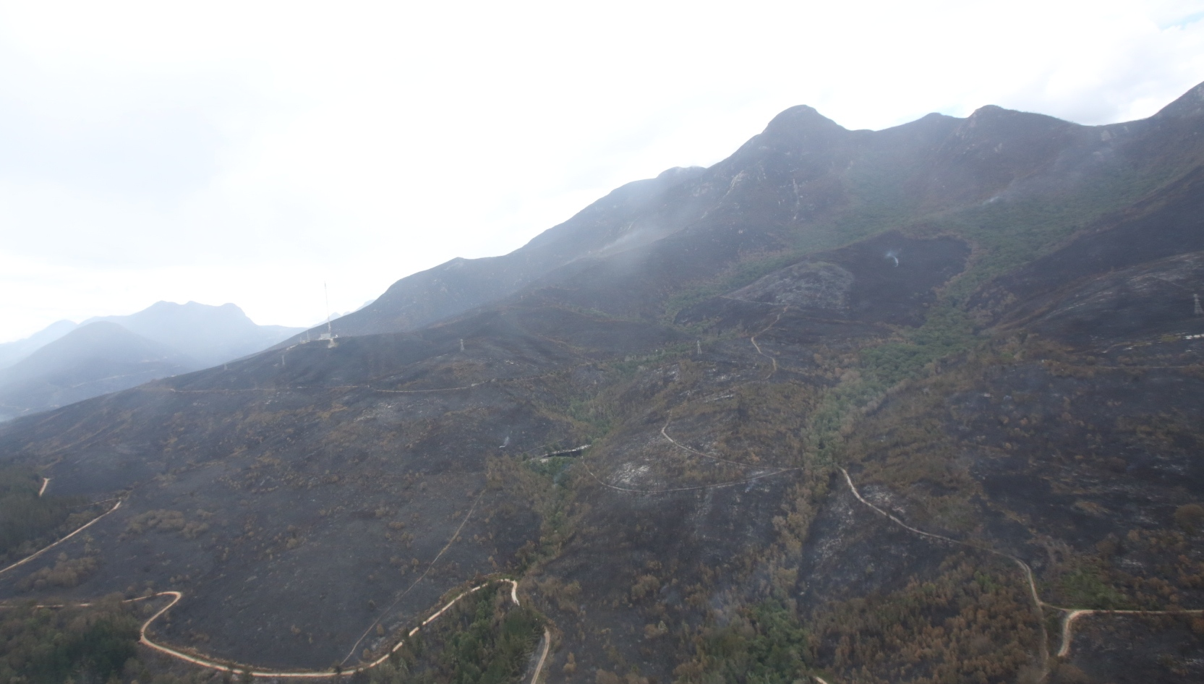
Headline
Text
www.gardenroute.gov.za

Slide 18
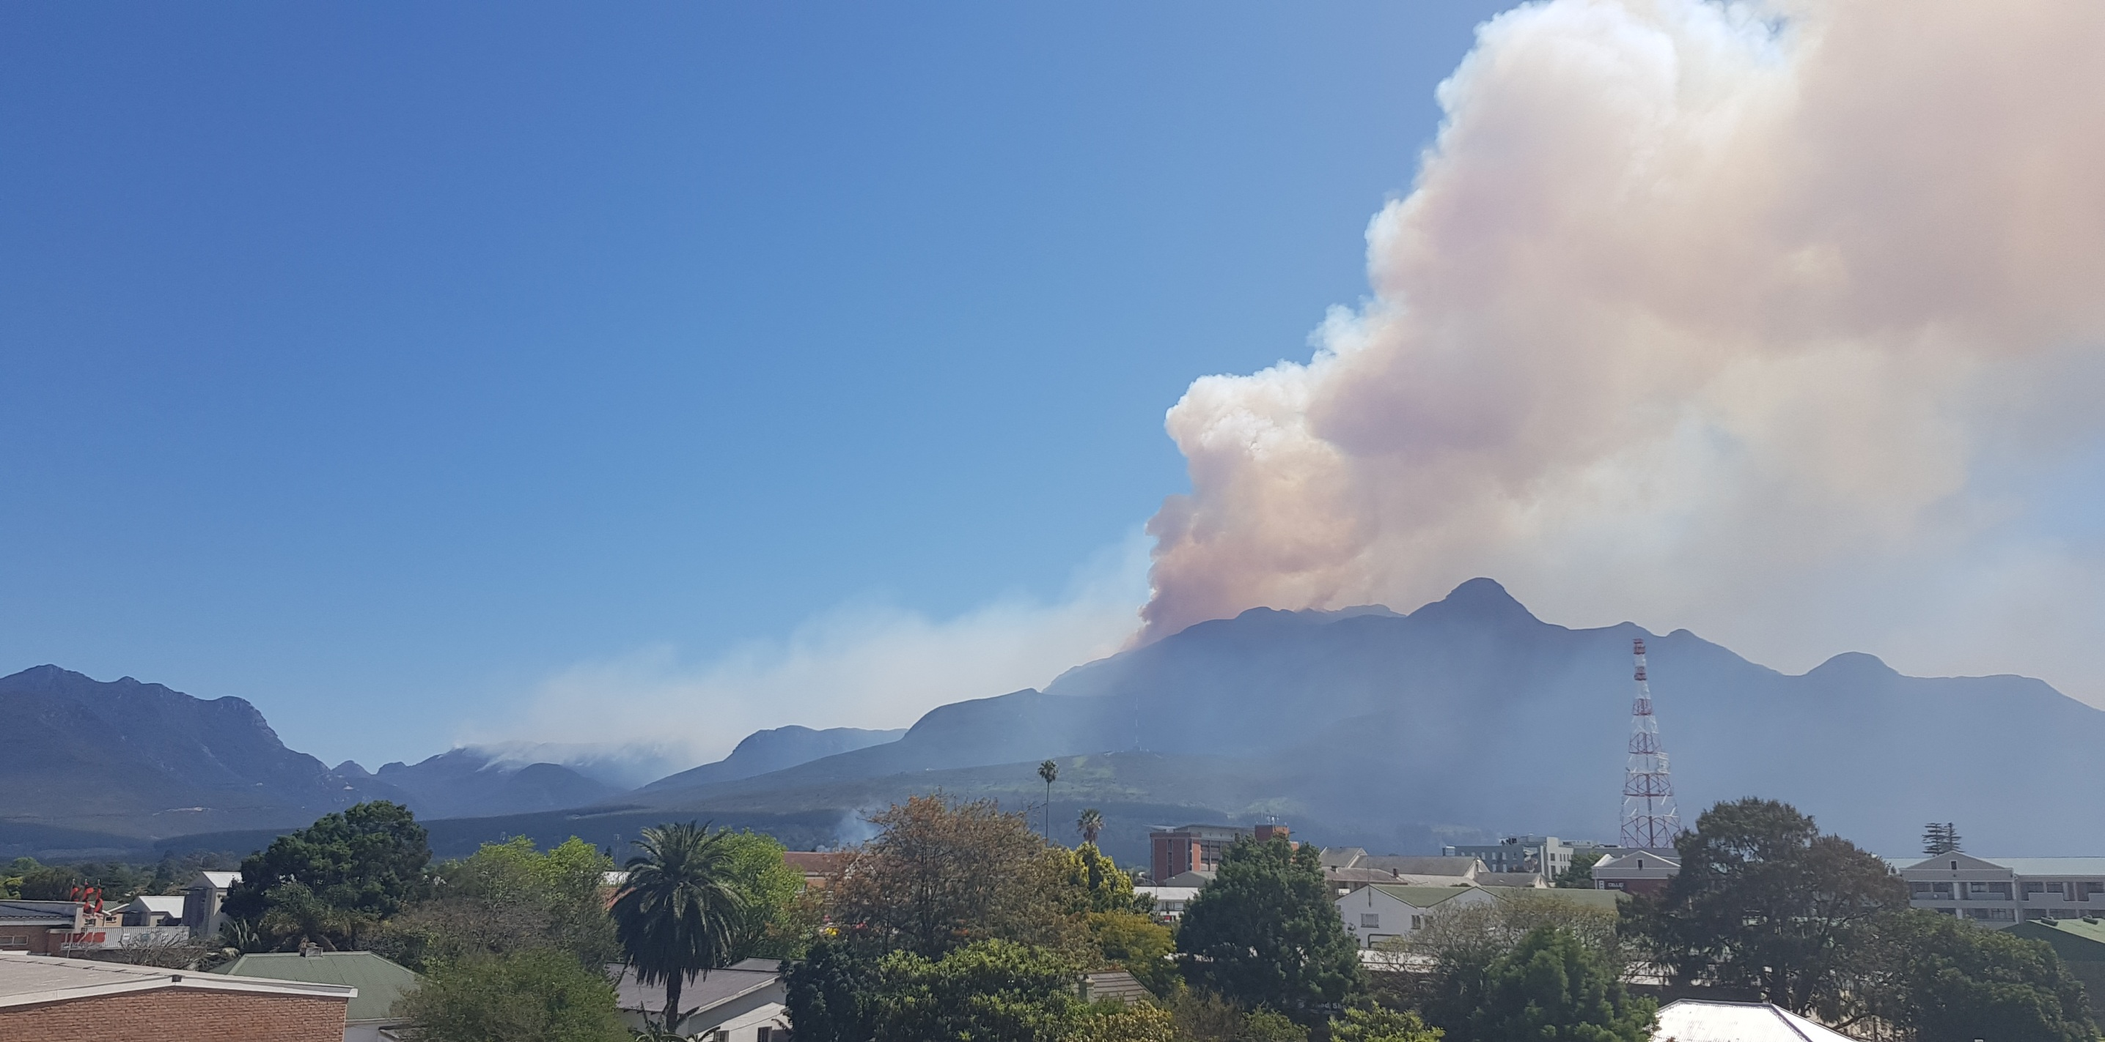
Headline
Text
www.gardenroute.gov.za

Slide 19
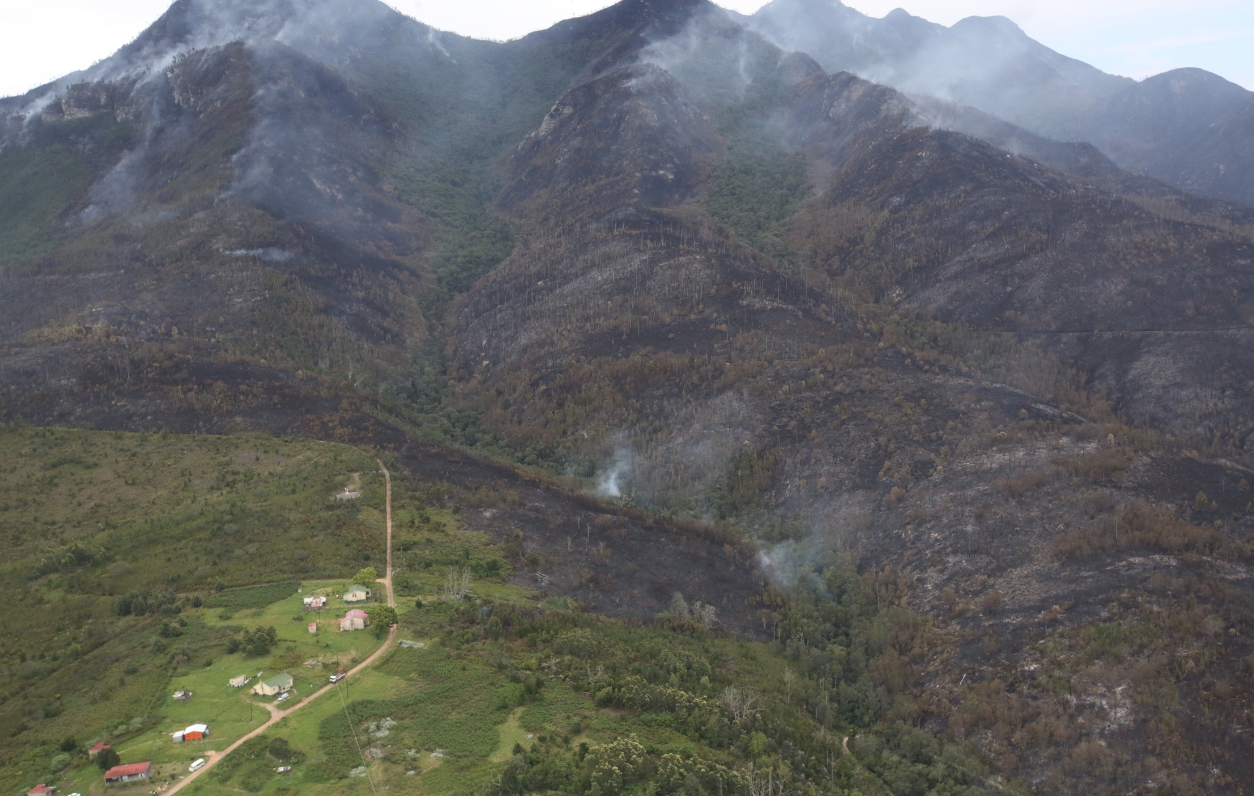
Headline
www.gardenroute.gov.za

Slide 20
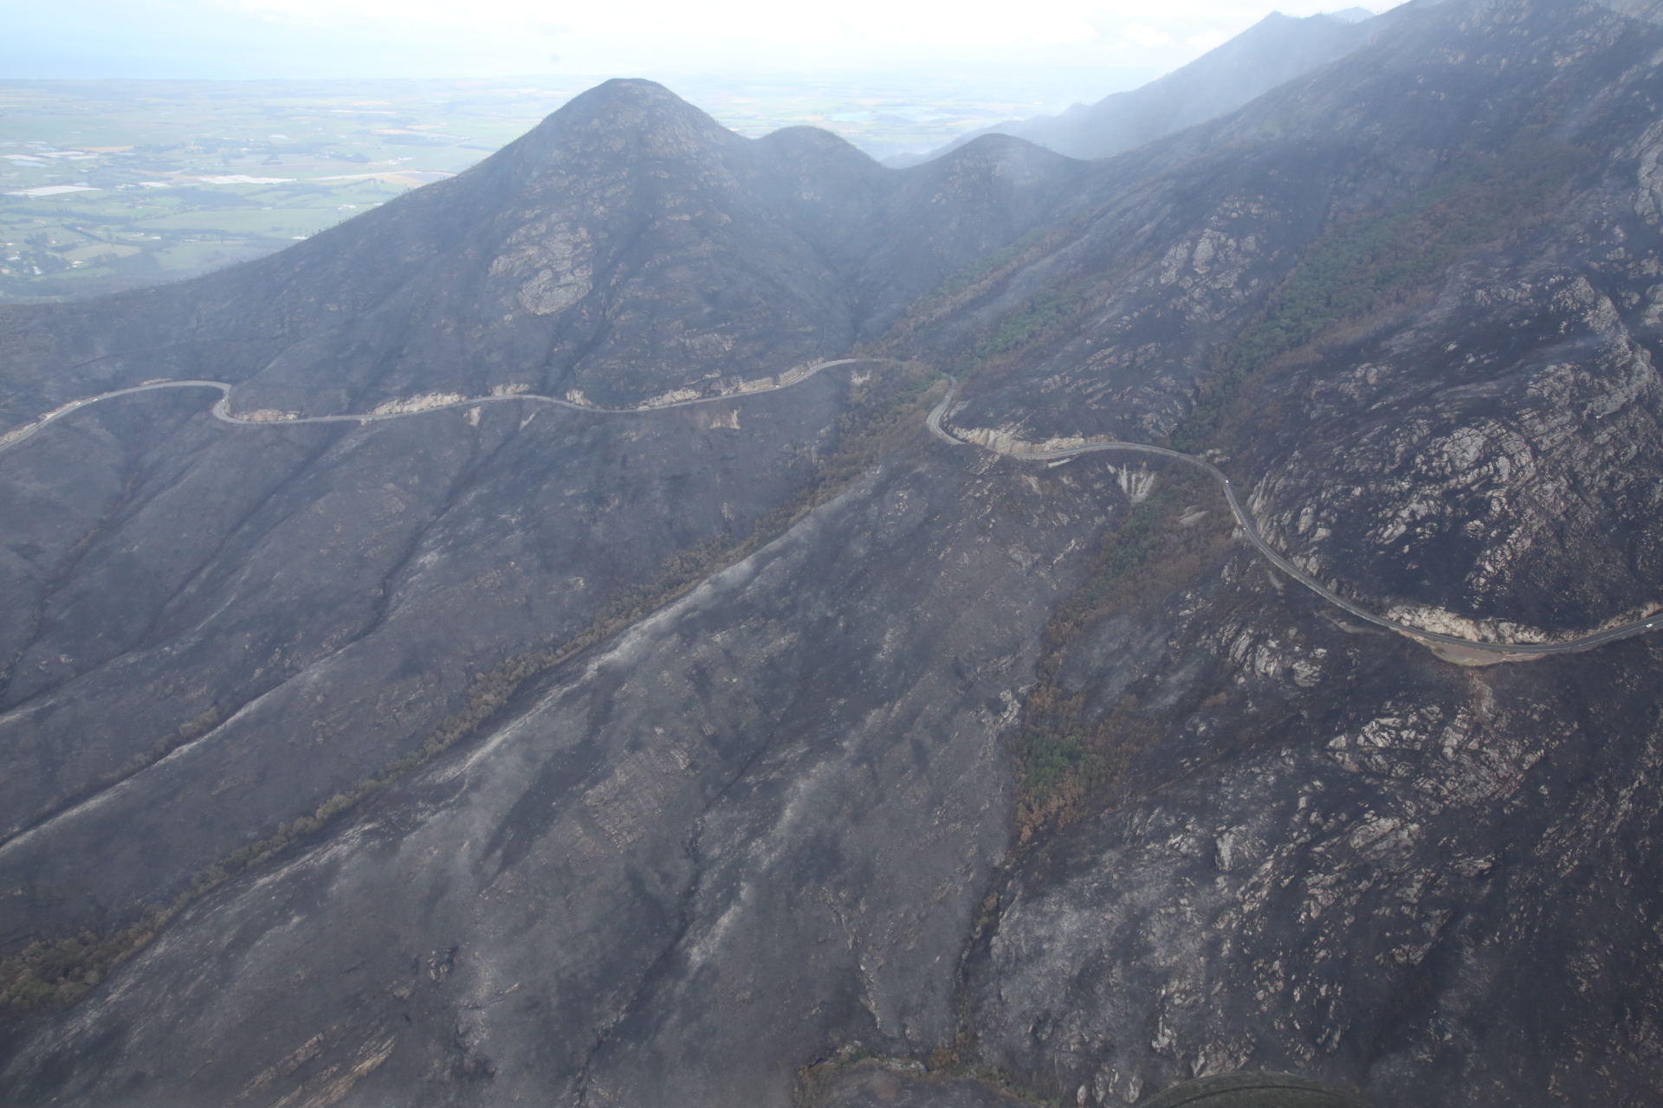
Headline
Text
www.gardenroute.gov.za

Slide 21
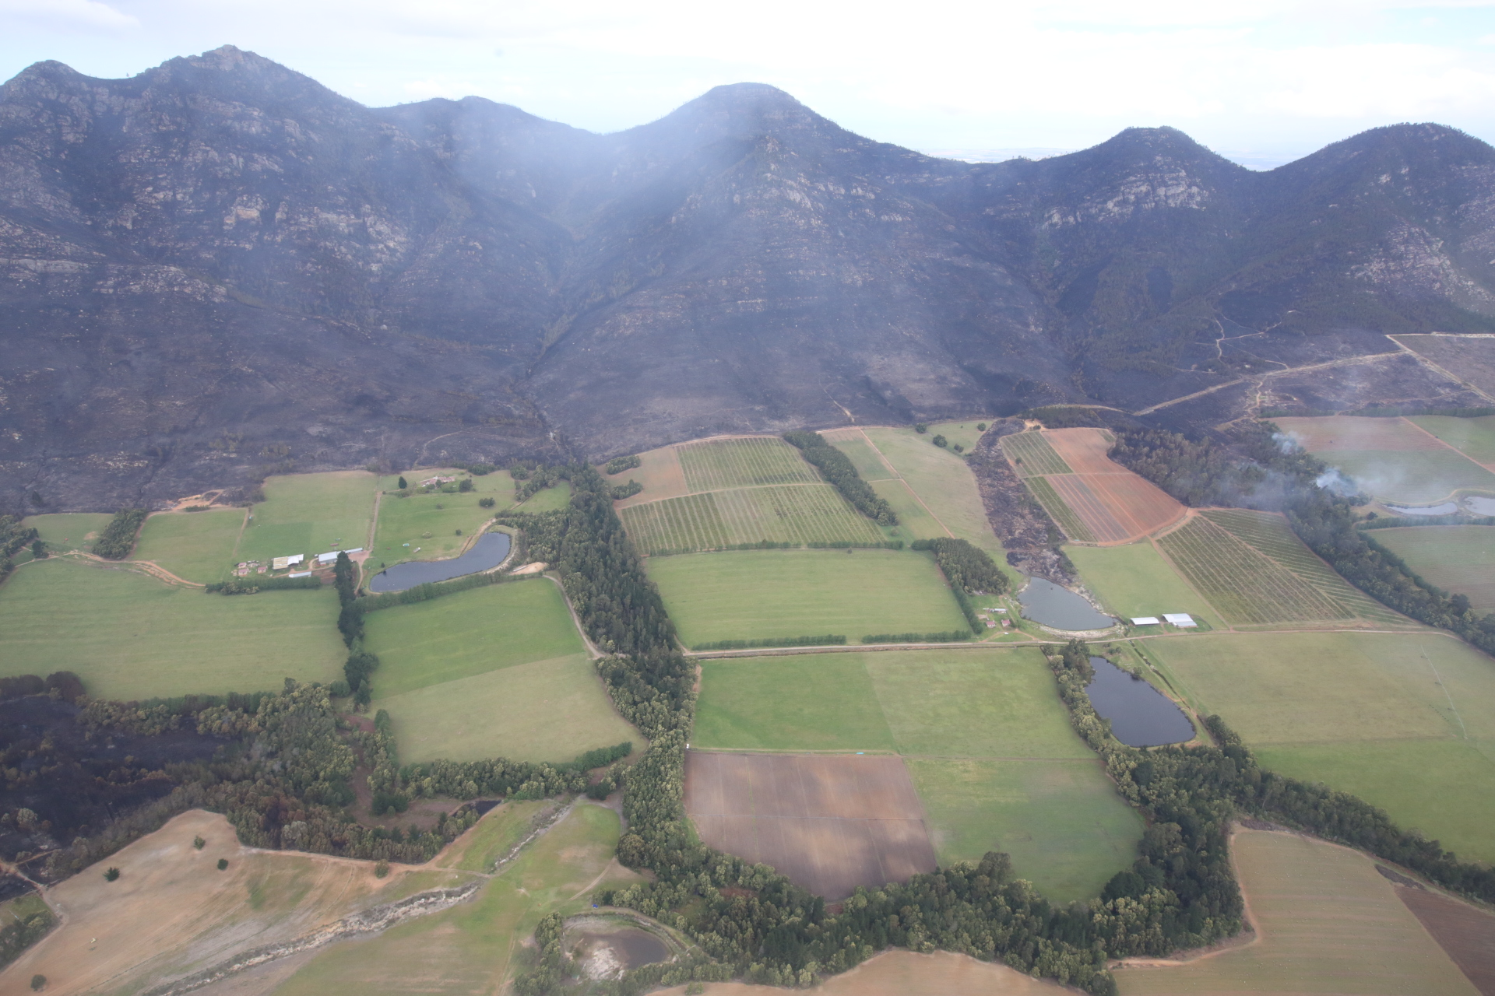
Headline
Text
www.gardenroute.gov.za

Slide 22
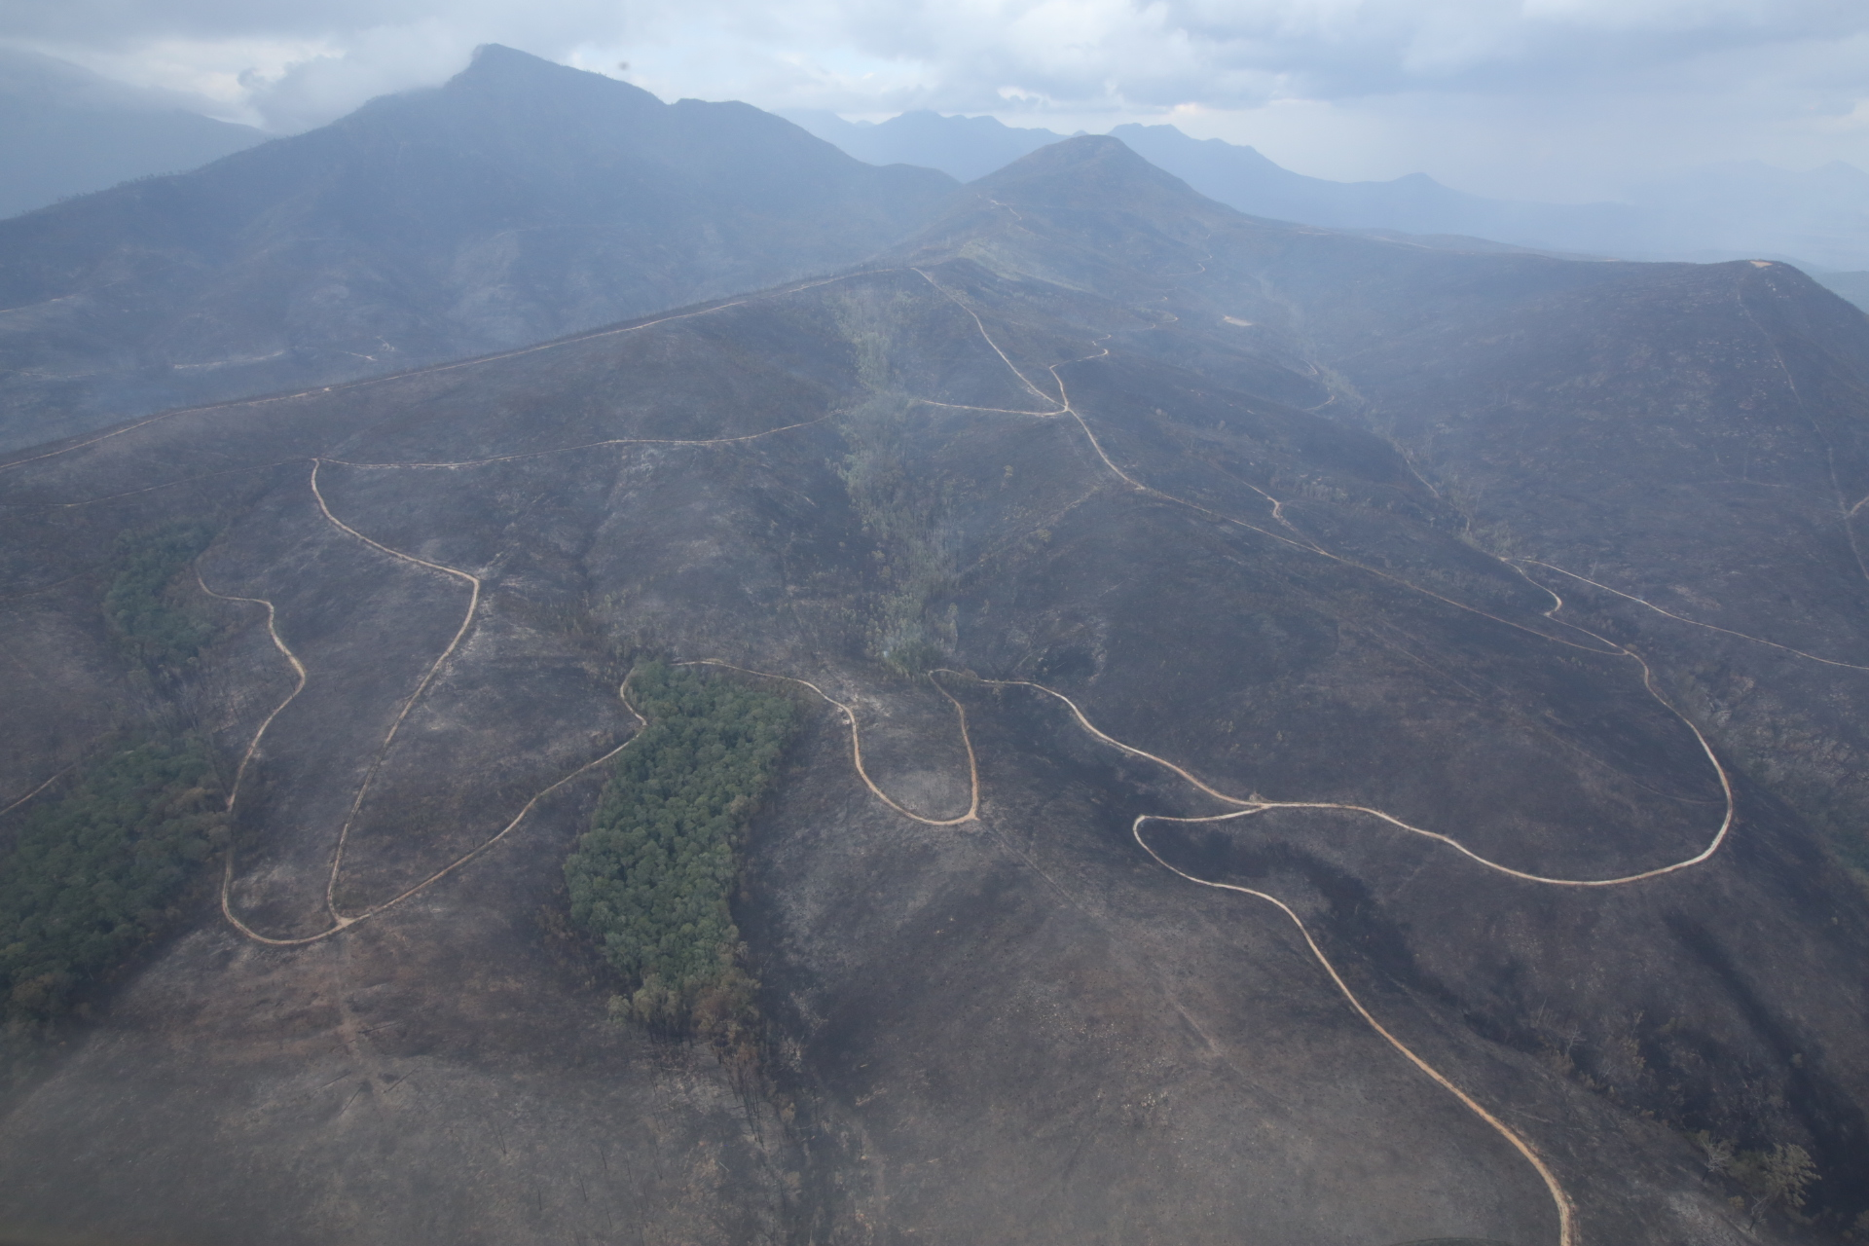
Headline
www.gardenroute.gov.za

Slide 23
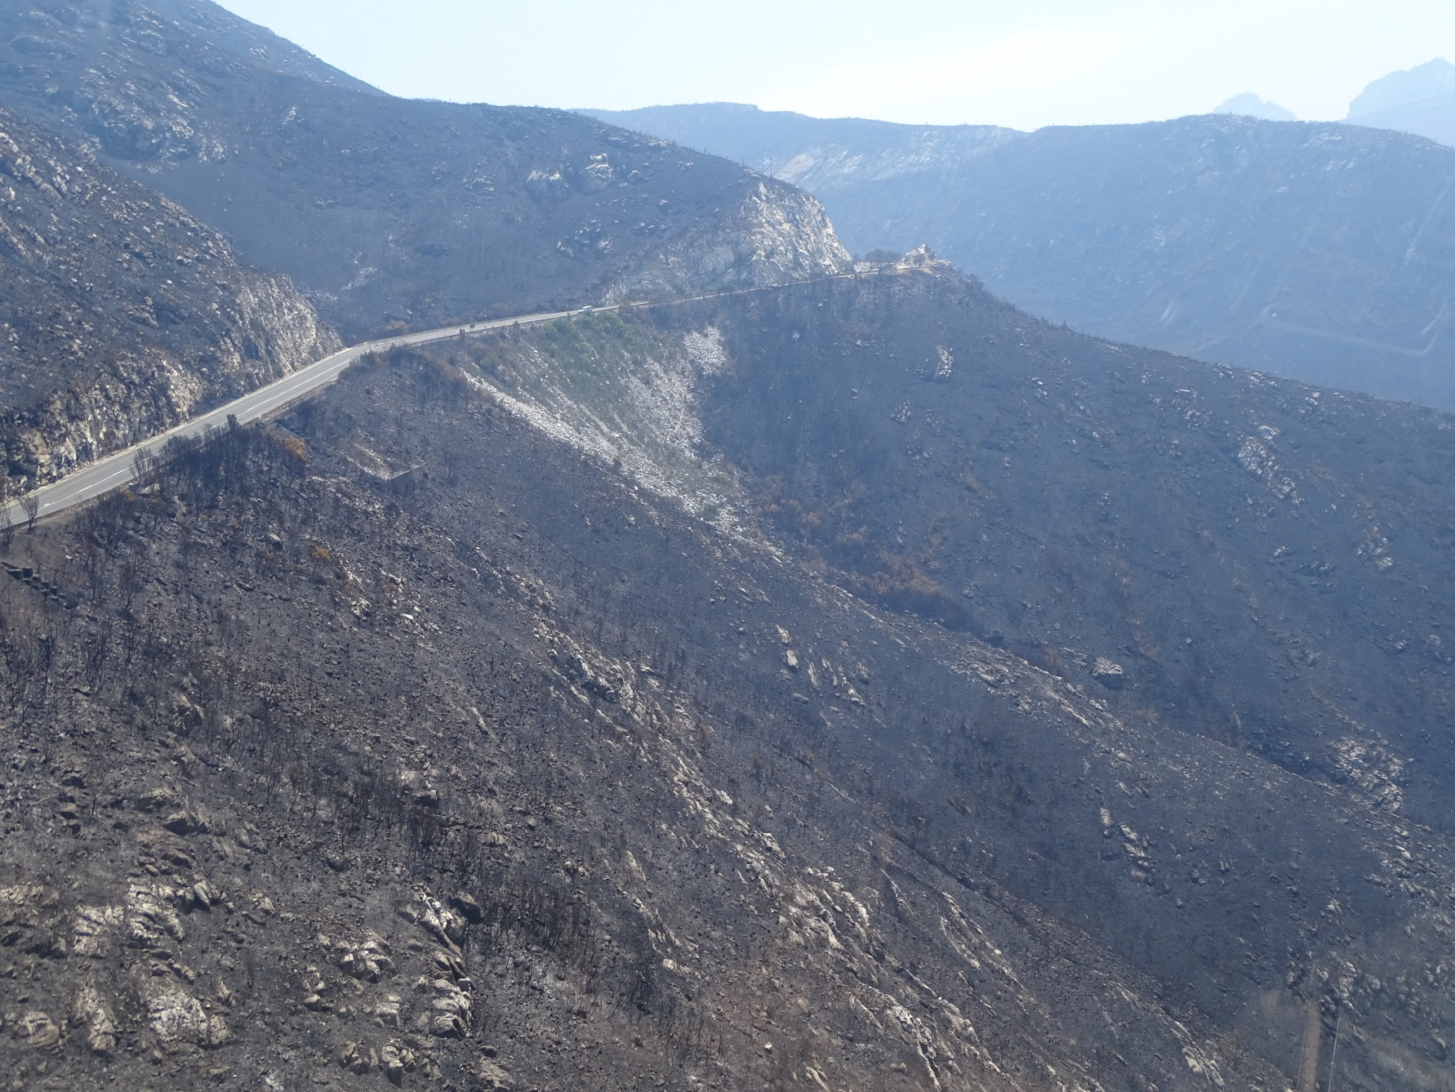
Headline
www.gardenroute.gov.za

Slide 24
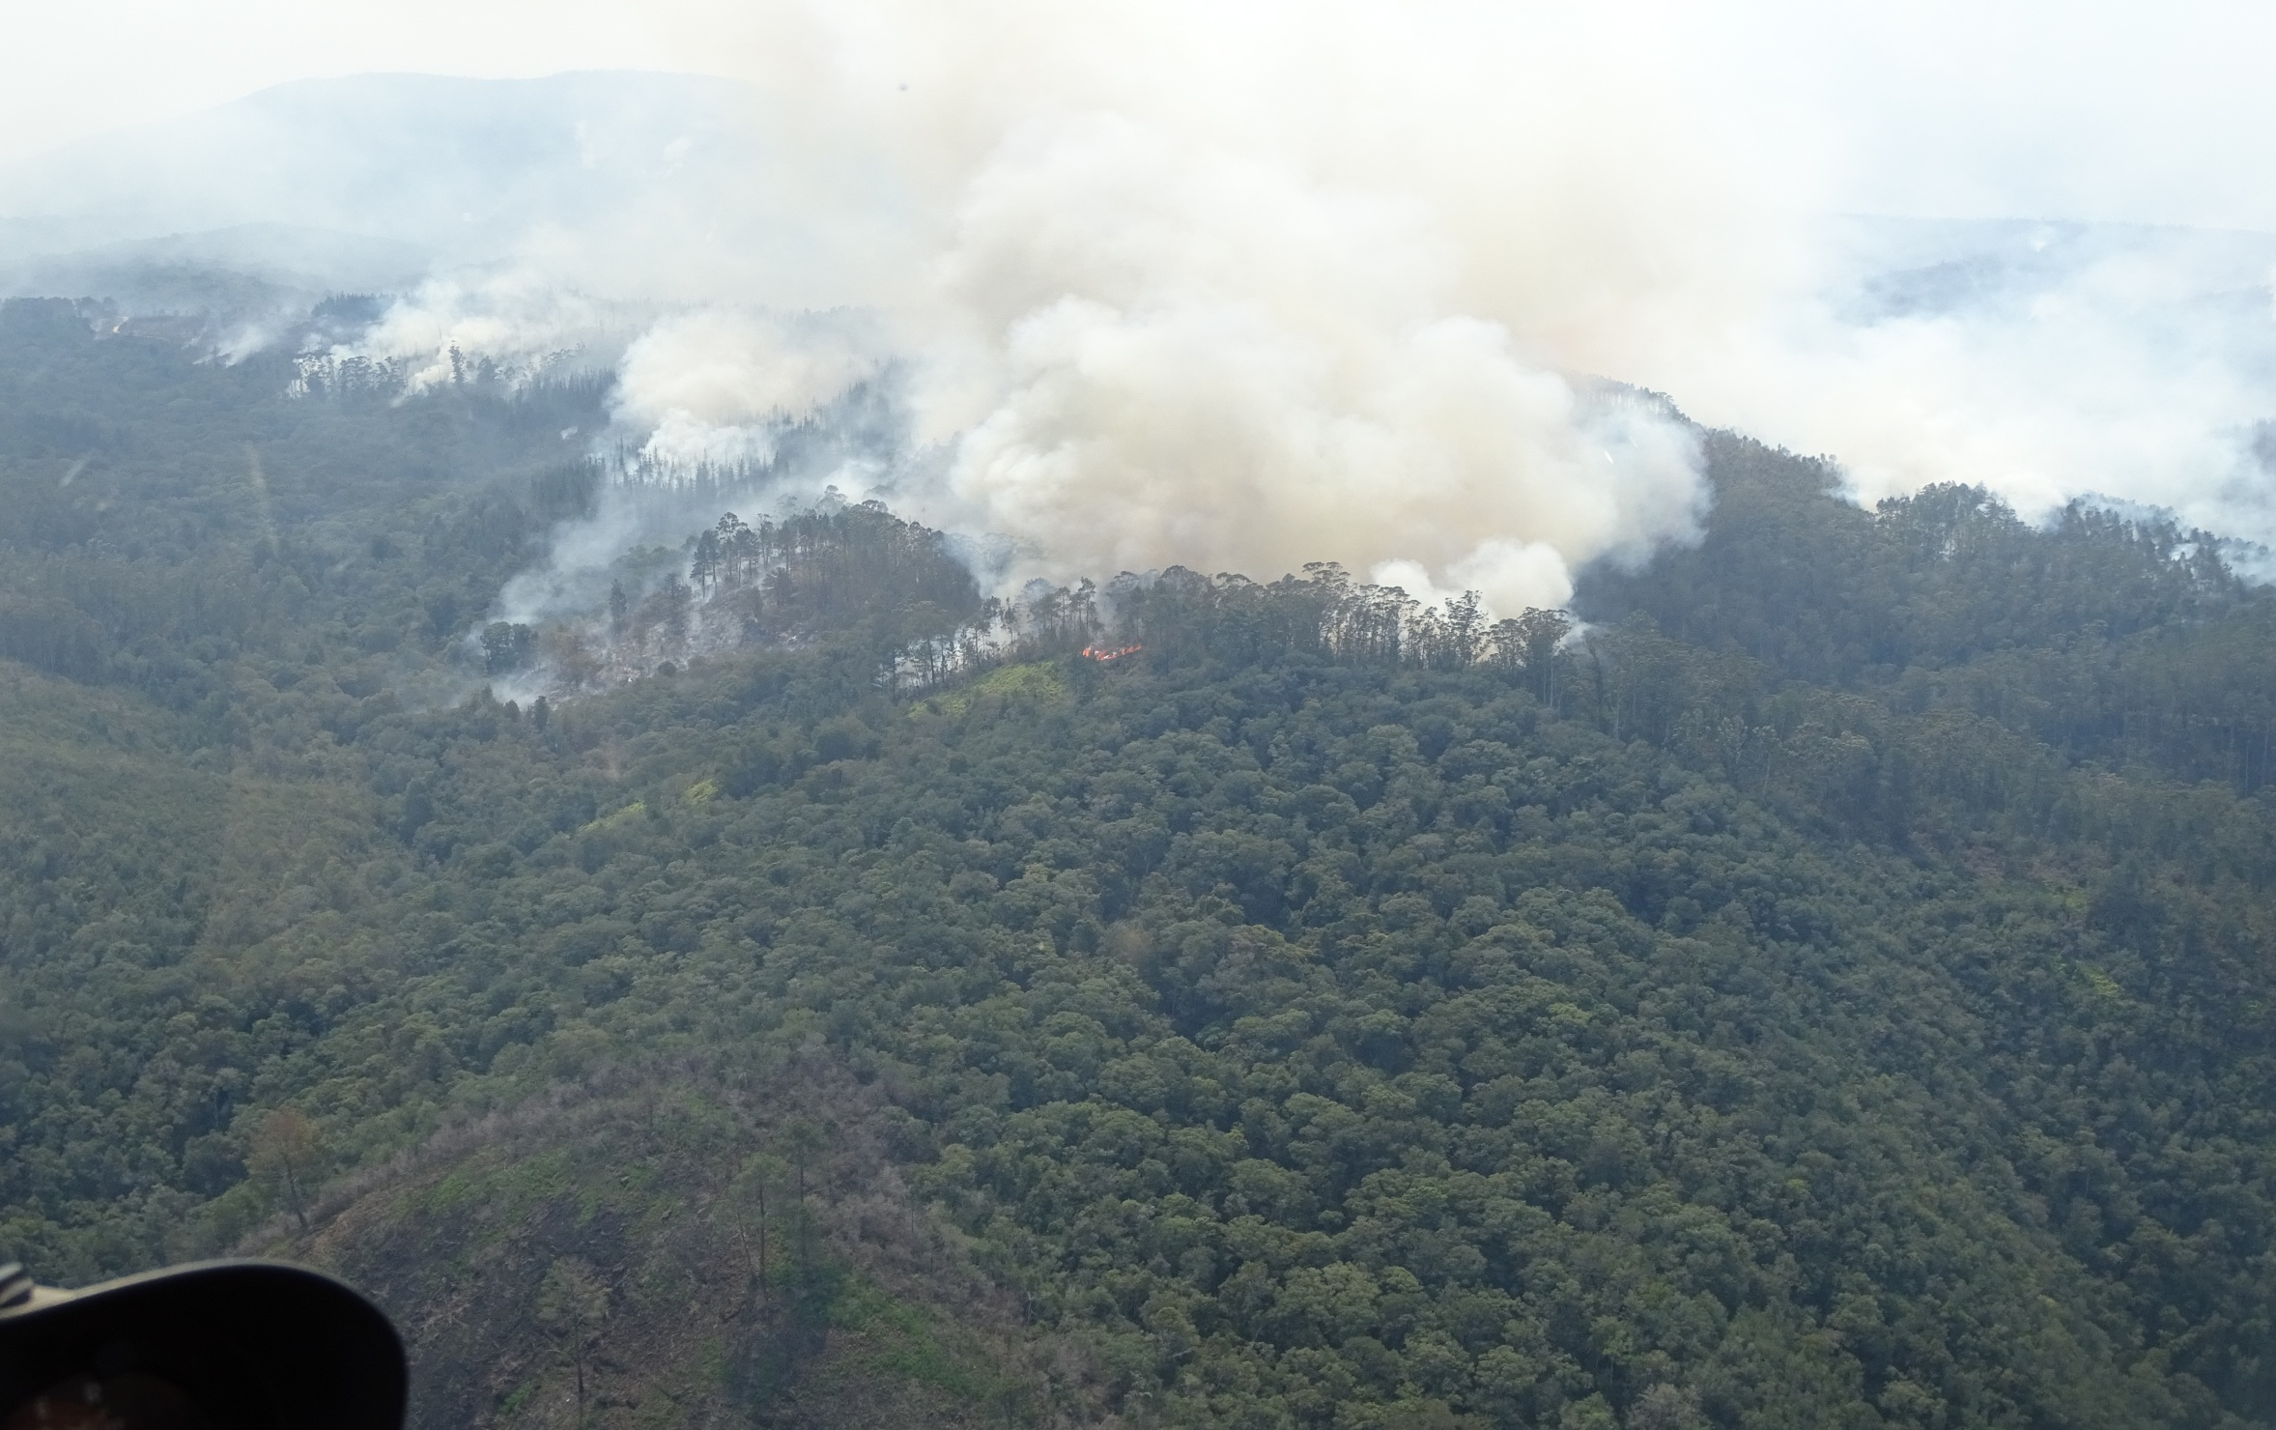
Headline
www.gardenroute.gov.za

Slide 25
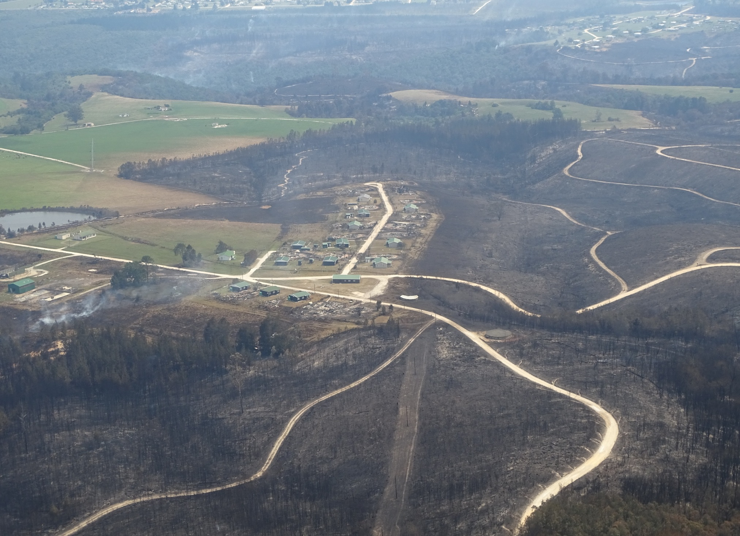
Headline
www.gardenroute.gov.za

Slide 26
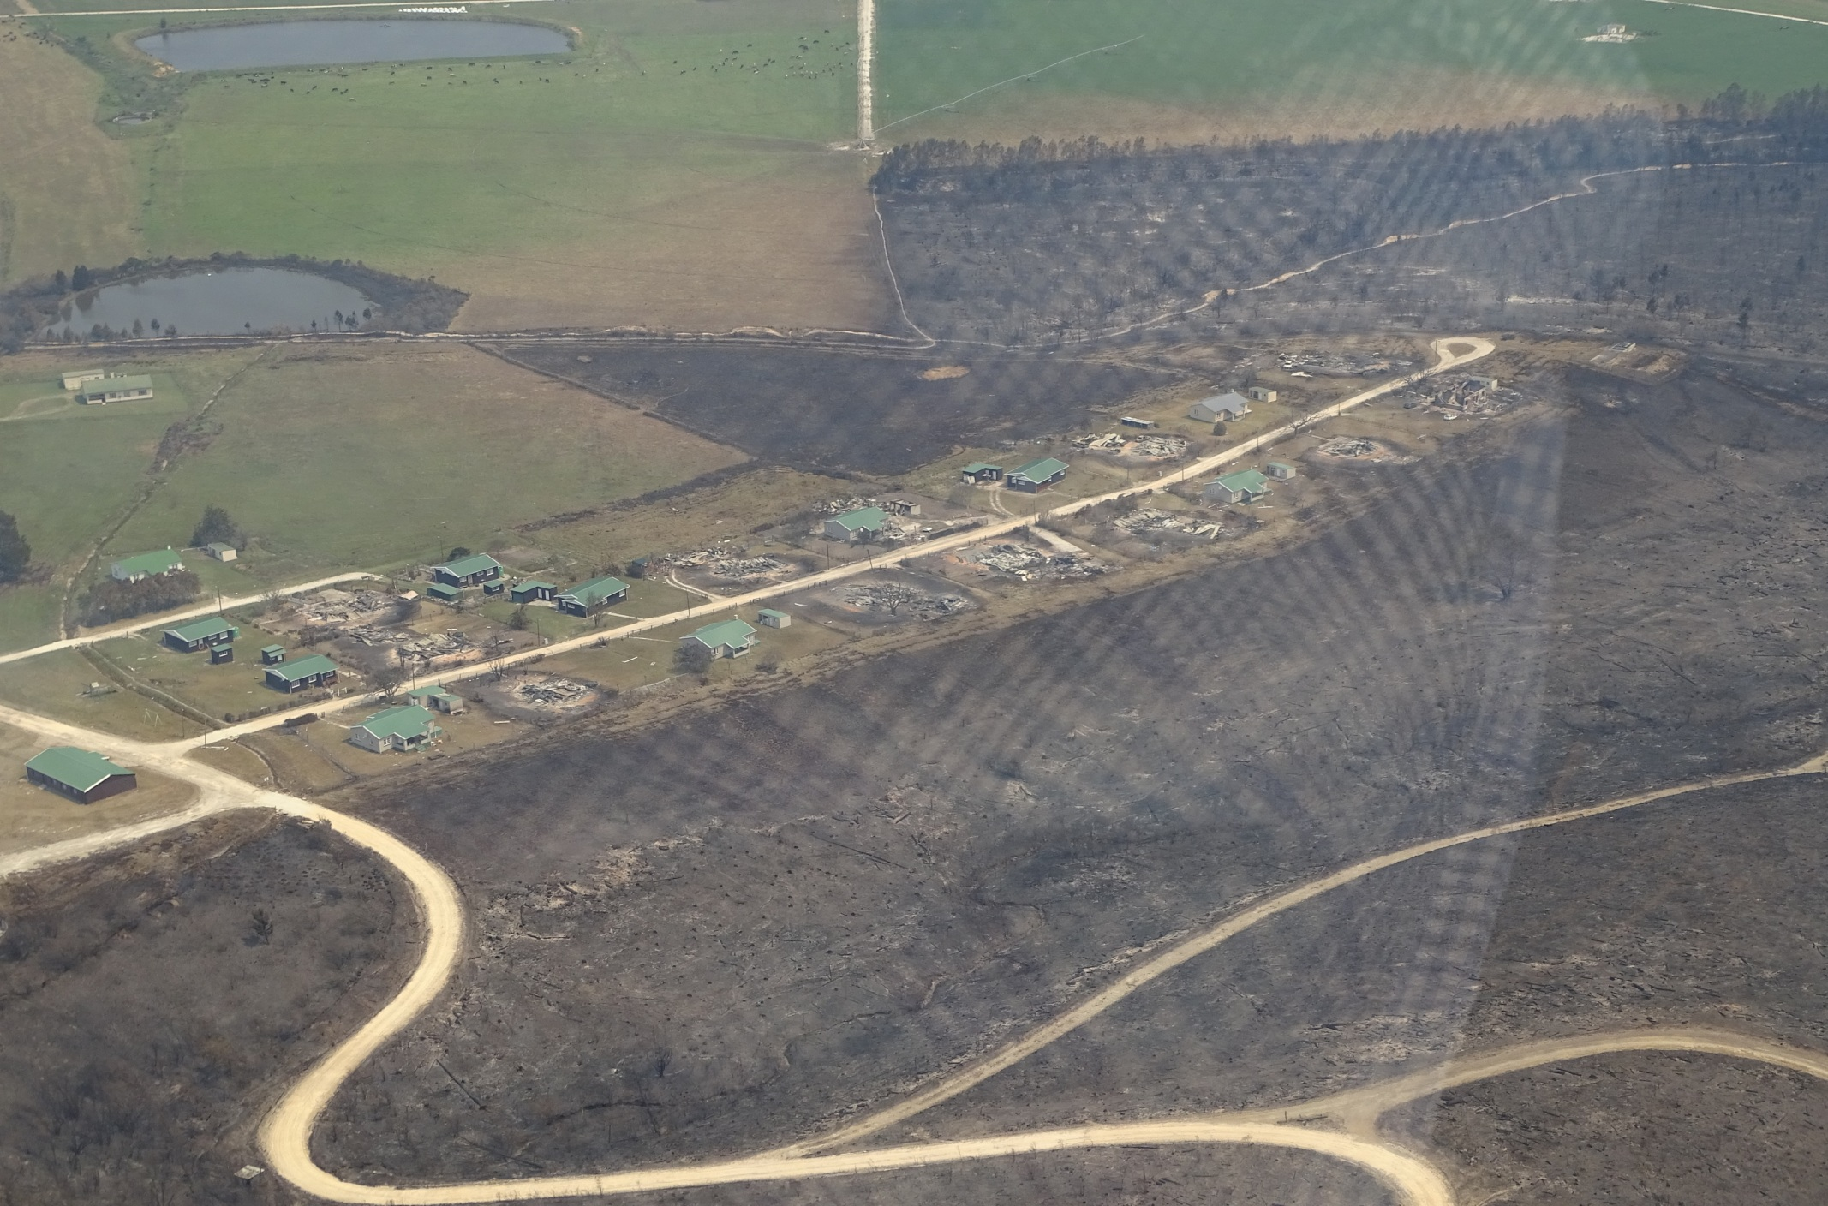
Headline
www.gardenroute.gov.za

Slide 27
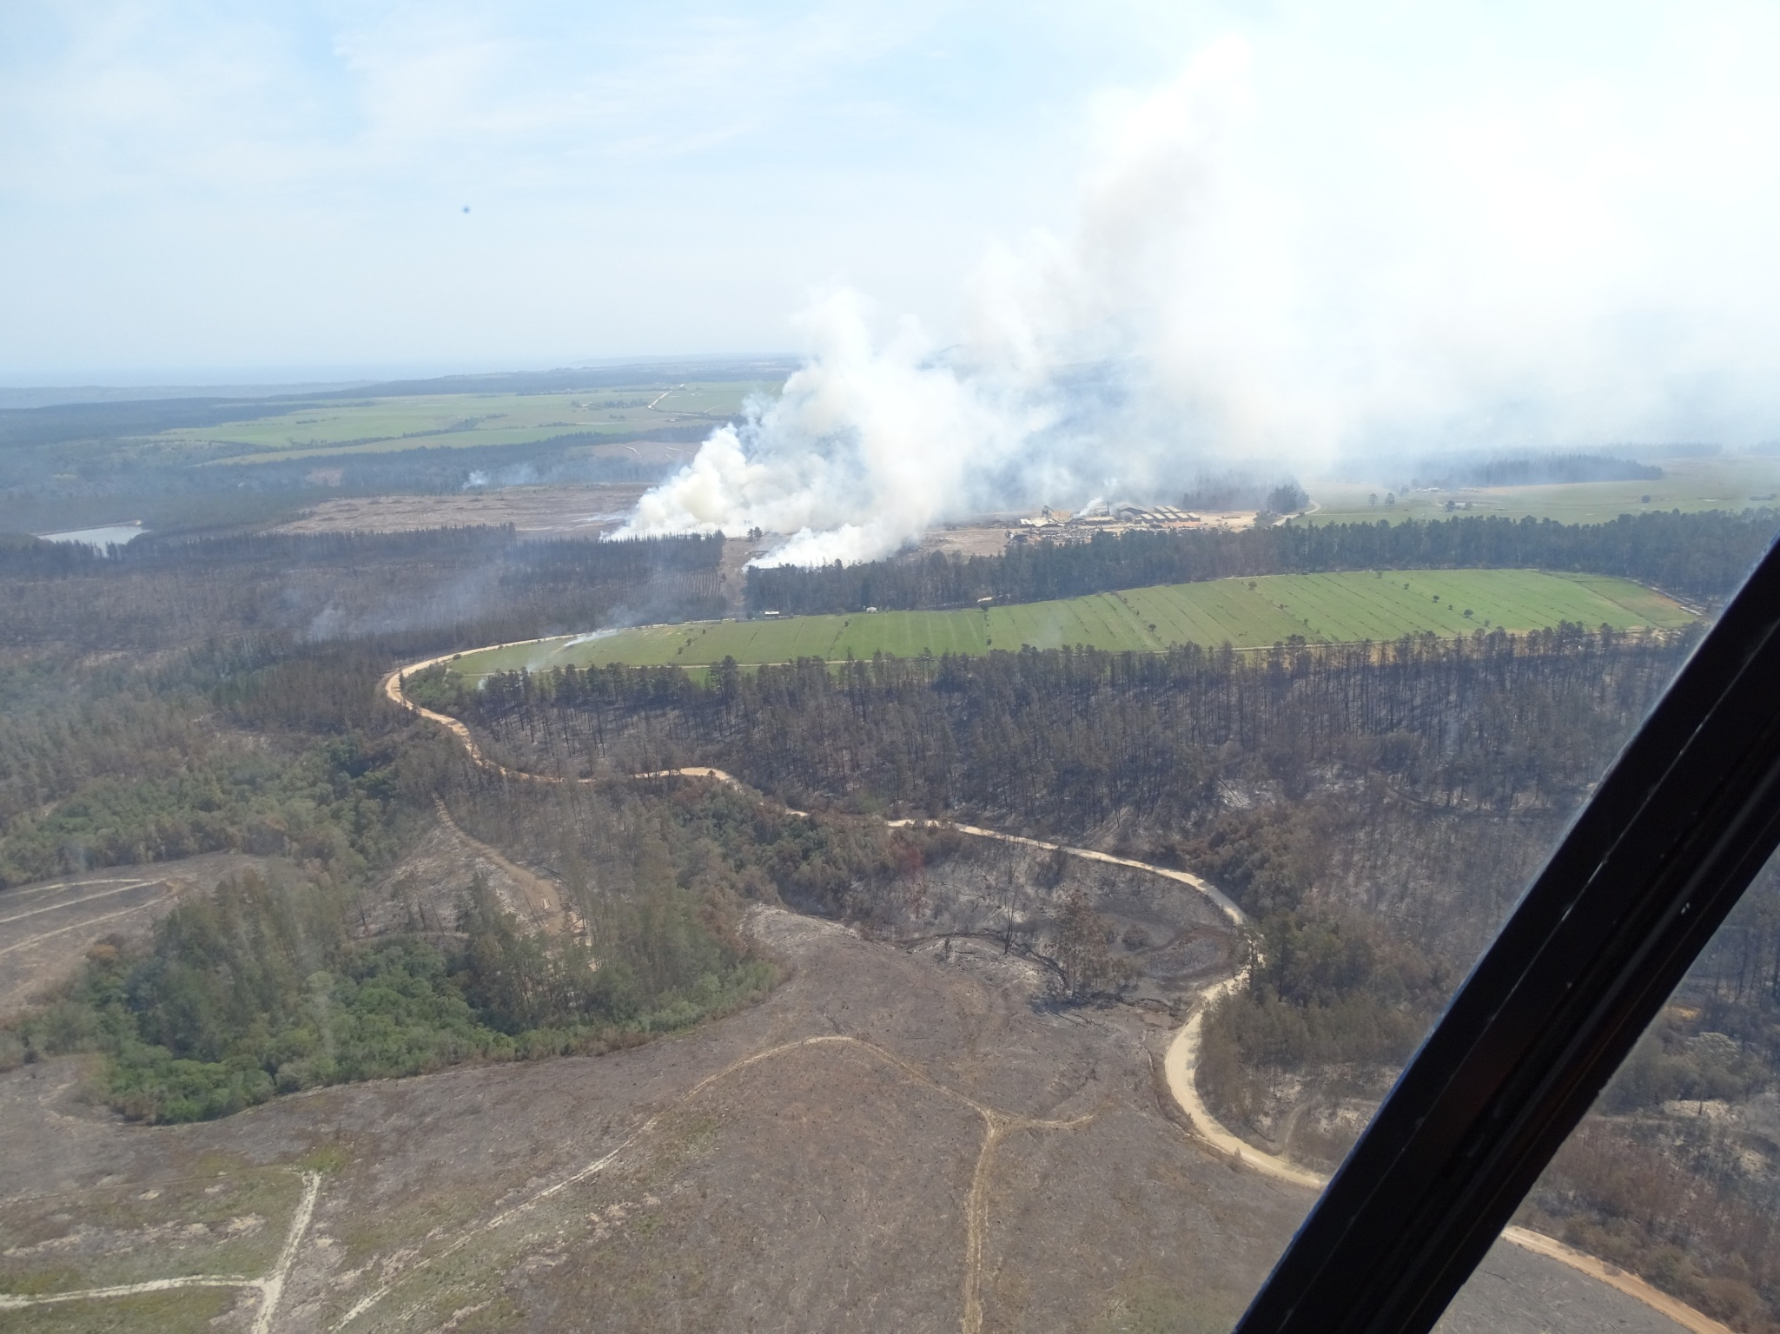
Headline
www.gardenroute.gov.za

Slide 28
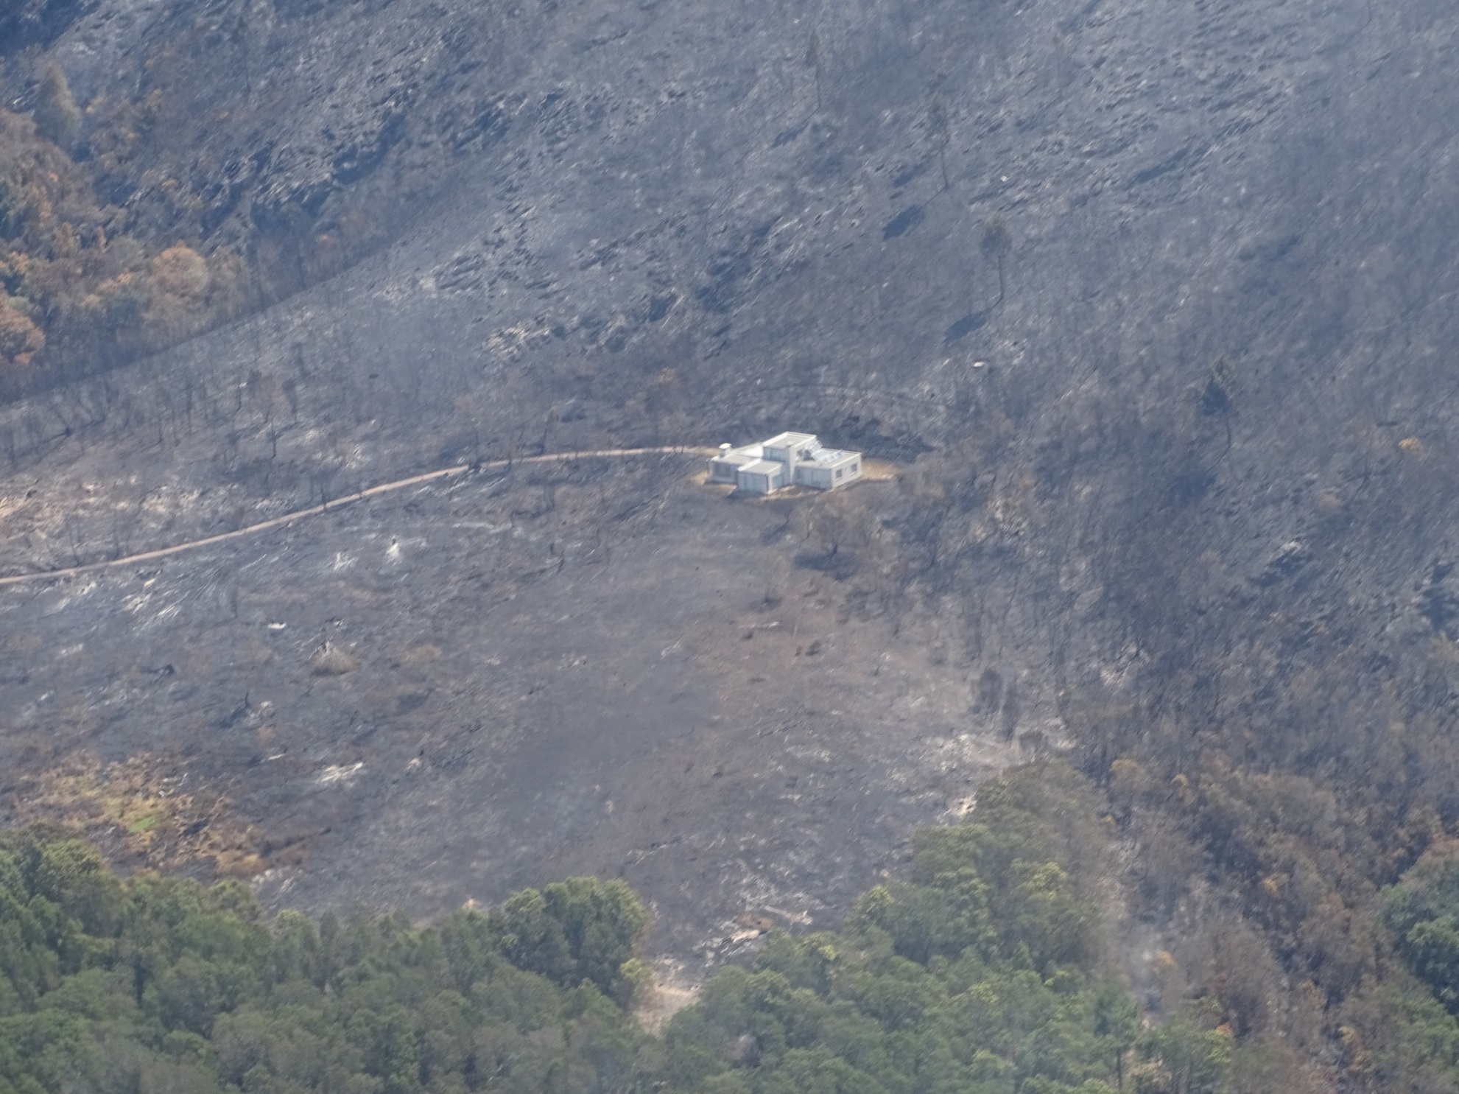
Headline
www.gardenroute.gov.za

Slide 29
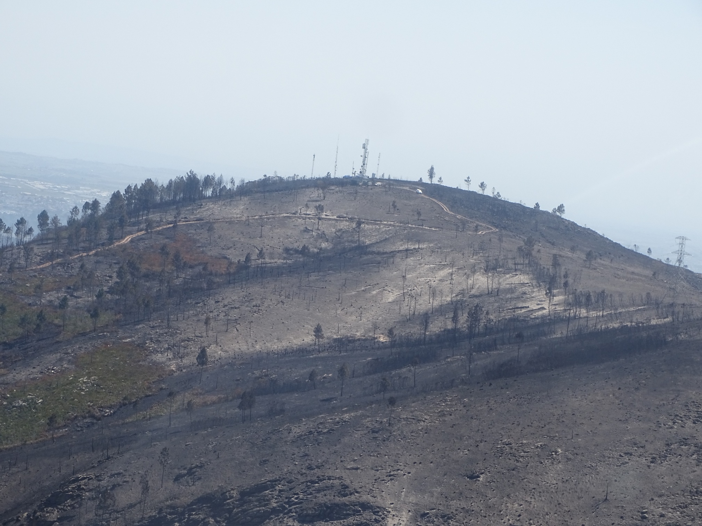
Headline
www.gardenroute.gov.za

Slide 30
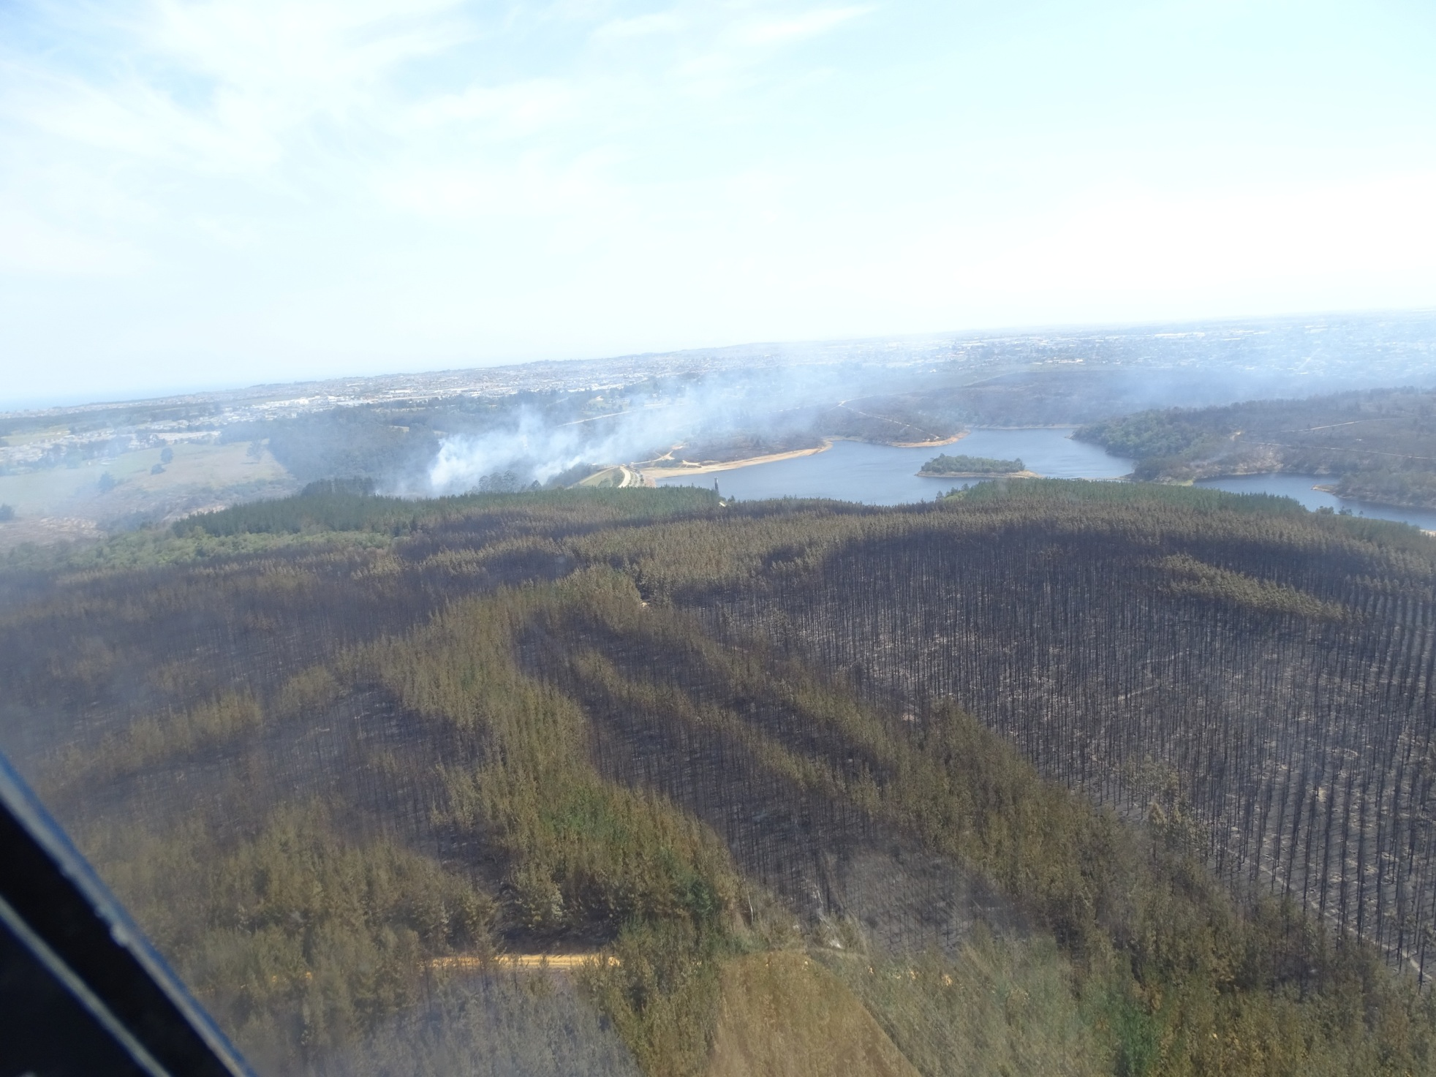
Headline
www.gardenroute.gov.za

Slide 31
Thank you Enkosi Dankie
Head Office: 54 York Street, George Tel: 044 803 1300
www.gardenroute.gov.za
info@gardenroute.gov.za

