Slide 1
MARK CAPPER
smart Metering
August 2016
IMESA Southern Cape Quarterly Meeting.

Slide 2
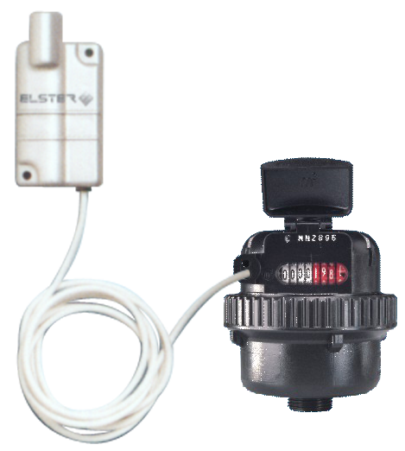
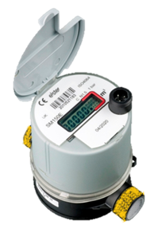
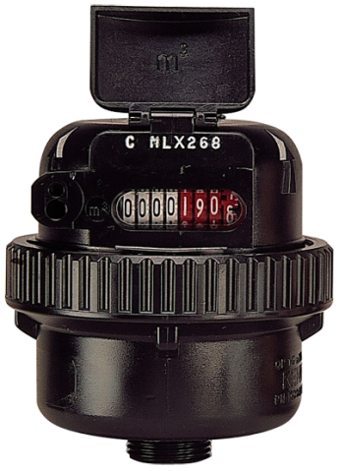
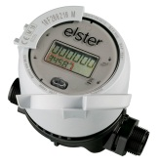
Meters Are Evolving ……….
Mechanical ‘dumb’ meter
Mechanical with external smart modules
Smart hybrid meter with integrated smart
Electronic meter with / w/o integrated AMR
Mechanical
Hybrid
Electronic

Slide 3


Trends In Water Metering
“To measure is to know” – Lord Kelvin
“every drop” of water that is sourced needs to be accounted for throughout the supply chain
Trends - reliable and accurate basic metering and solutions that add value:
Good Revenue Meters – reliable and accurate meters – good volumetric and hybrid meters
Water Management Devices (WMD) – FBW, shut-off valve
Prepayment (STS) – similar system to electricity PP, costs
Automatic Meter Reading (AMR) – walk-by / drive-by for value and consistent readings, Cellular / LoRa AMR. Logging
Meter Data Management (MDM) – Smart Metering, Cloud-based, Internet of Things (IoT), Mobile Applications – Billing, Leak Detection, Logging
For value - a reliable and accurate good revenue generating meter
Water meters are the cash registers
for water suppliers

Slide 4
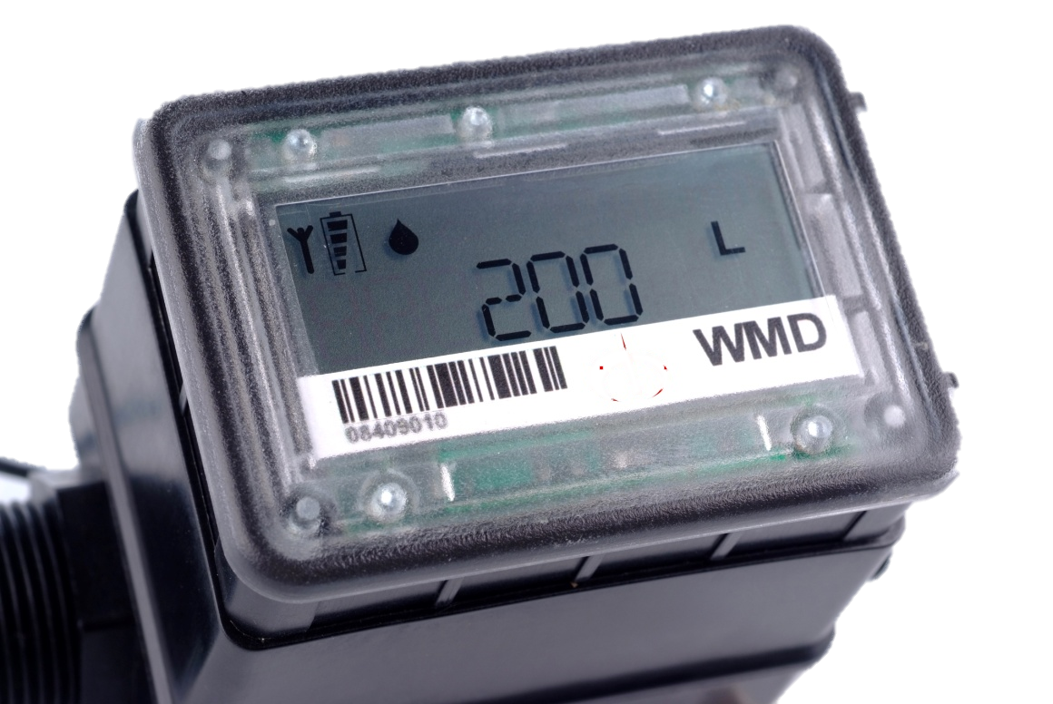
Water Management Devices (WMD)
Electronically controlled valve connected to a pulse output water meter
The delivery of an allocation of a finite or pre-negotiated daily or monthly water allowance (free basic water)

Slide 5
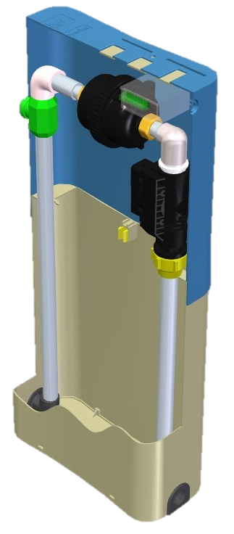
Prepayment Solutions
Domestic Water Dispensers are designed for individual households to control the dispensing of pre-paid quantities of water, available in Dallas token or STS prepayment (similar to electricity prepayment)
The prepayment meter is programmable to issue the minimum 6kl of free basic water (FBW) and thereafter it has a step tariff function which then charges for every kl used
There are two ways of dispensing the 6kl of free water:
200 litres of water per day or
6kl of water from the first day of the month until the allocation is reached thereafter water credit must be purchased

Slide 6
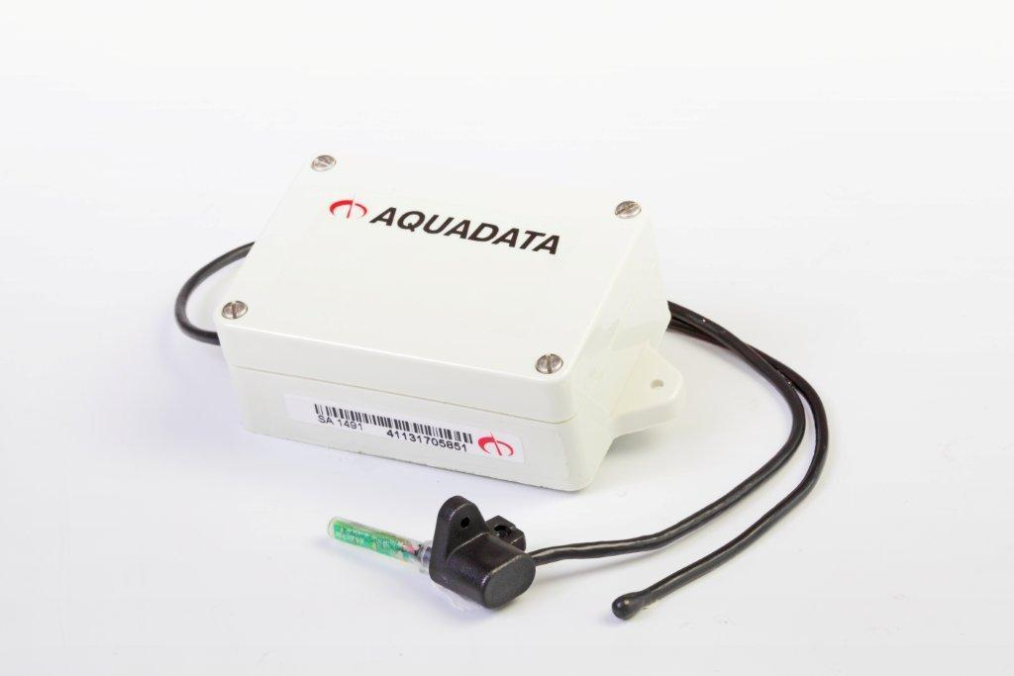
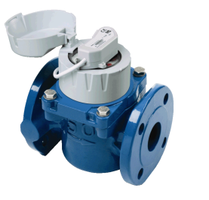
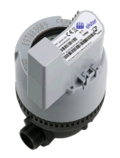
Automatic Meter Reading (AMR)
AMR (Automated Meter Reading) is the fundamental technology that enables:
Collection of data from meters via one-way communications
Integration of information back into a database for billing or data analysis
Eliminates manual readings, allowing billing to be based on actual consumption rather than on an estimate, giving customers better control of their water consumption

Slide 7

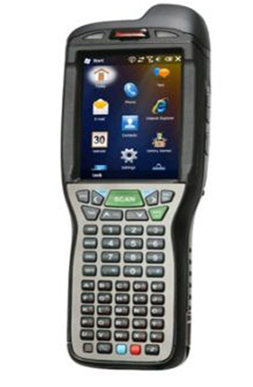
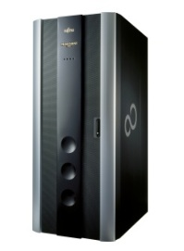
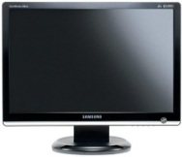
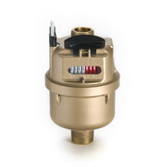
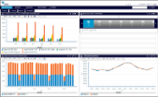
AMR - Description
Direct communication between meter and PC or Hand Held
Meter data visible in “real time”
Can be incorporated within customers billing (R & c)
Events: leak, tamper, burst
Simpler and lower cost e.g. Walk-by / Drive-by Vs Fixed Network
“Continuous” AMR = Logging
Direct

Slide 8
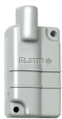
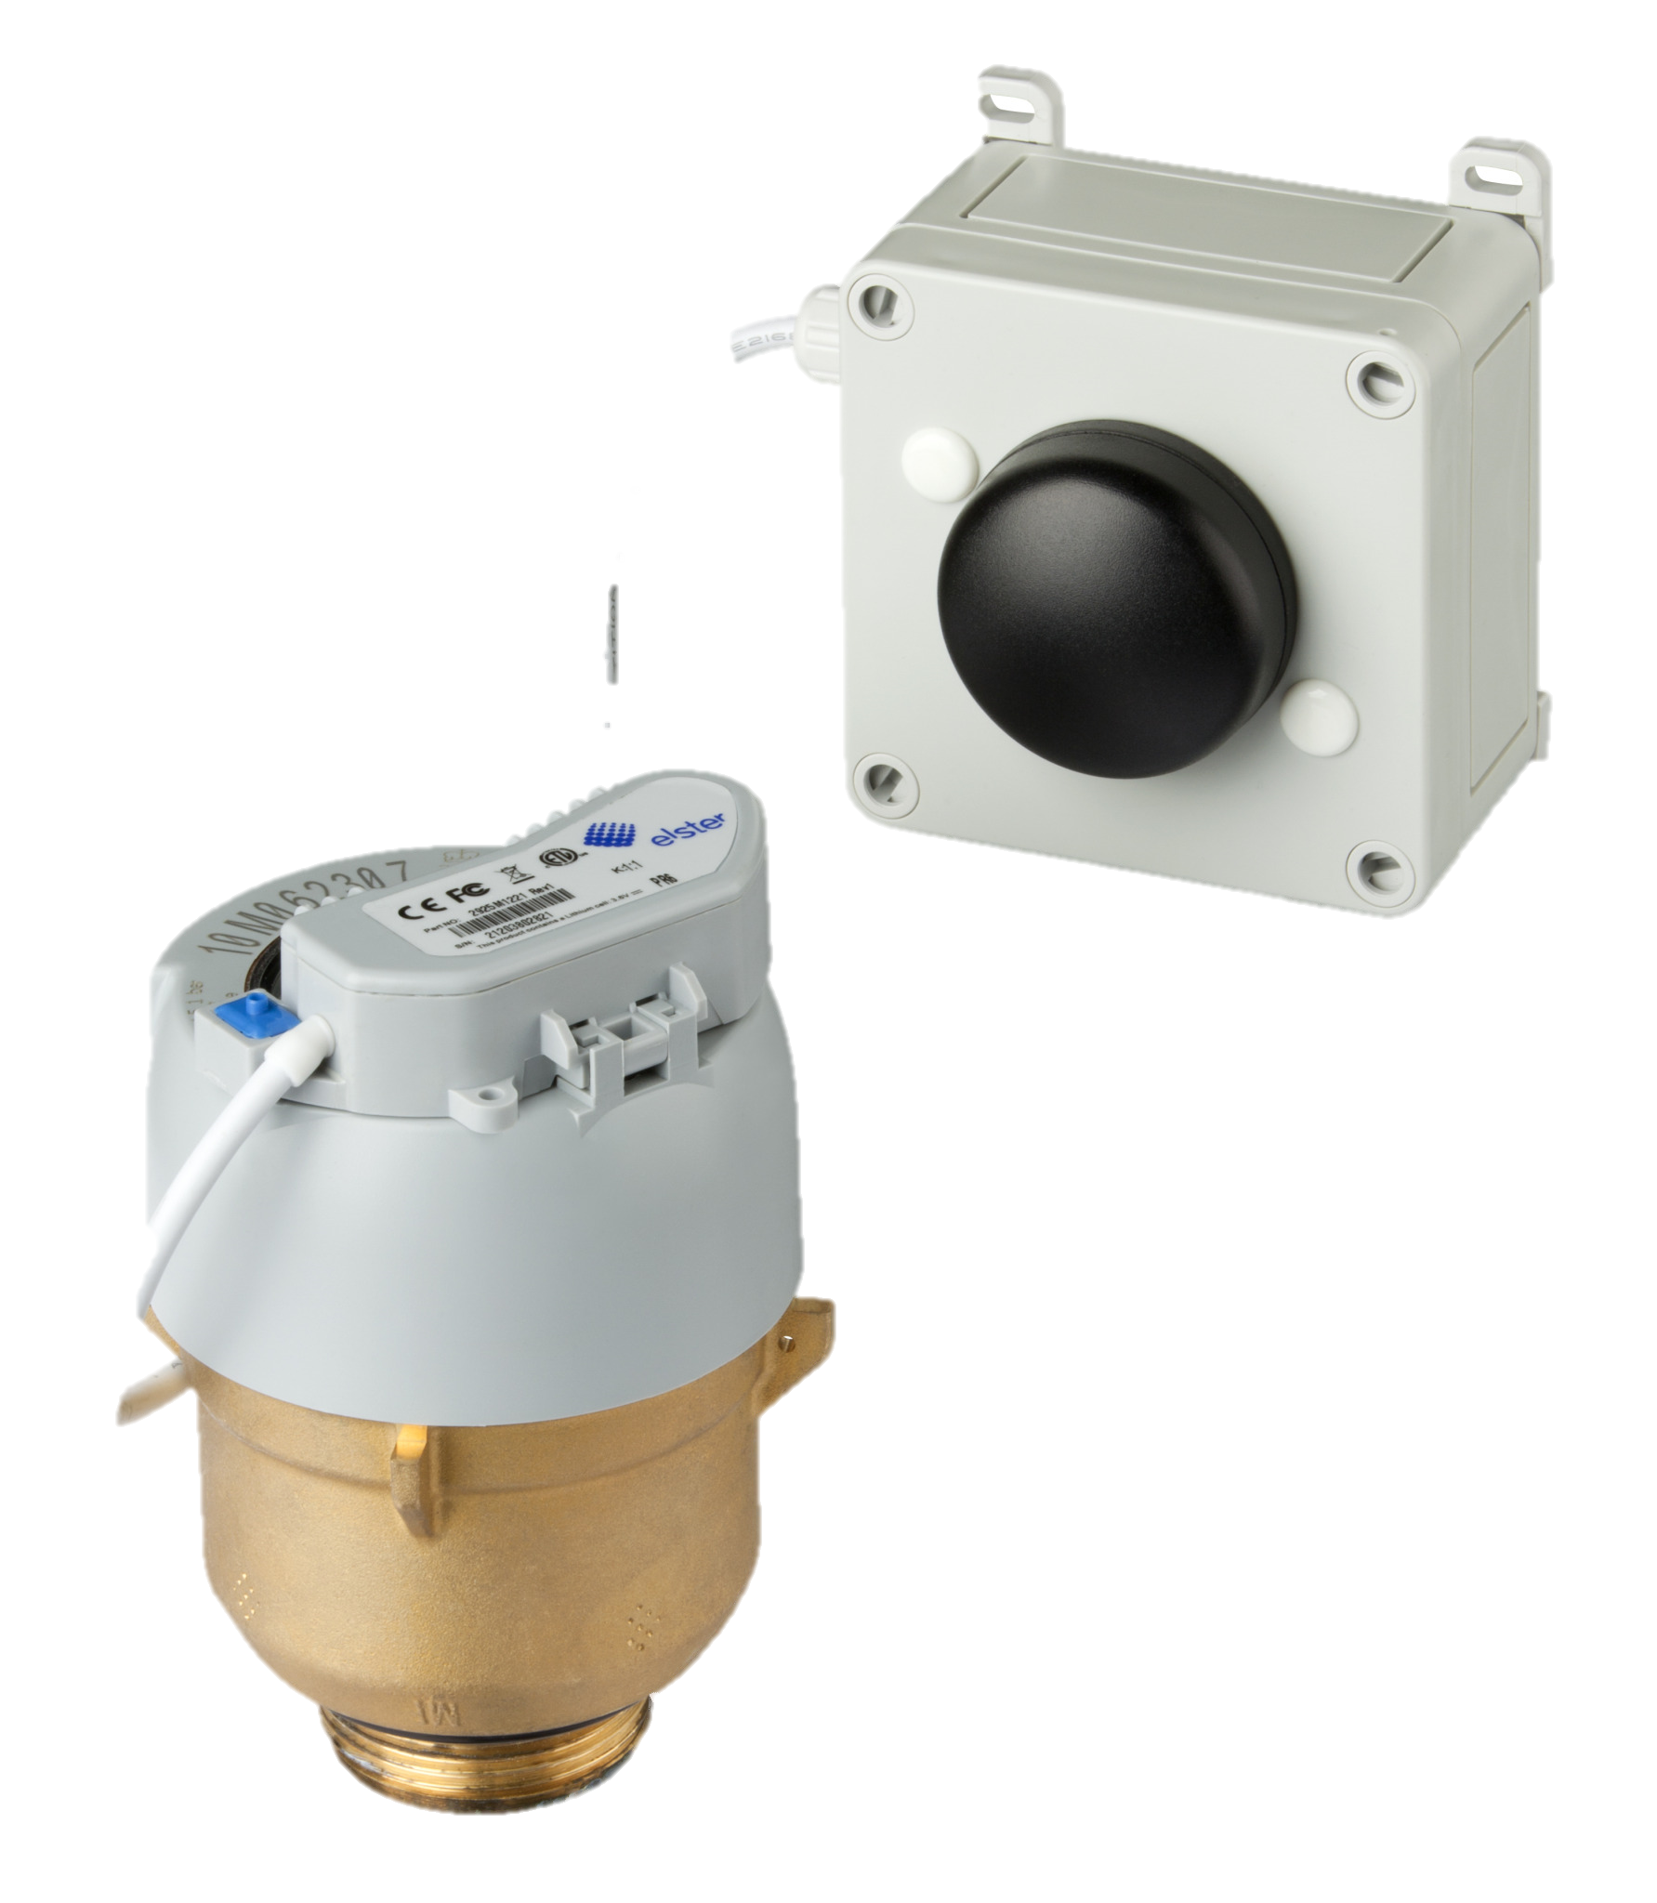
Advanced Metering Infrastructure (AMI)
AMI (Advanced Metering Infrastructure) refers to intelligent metering systems which:
Measure, collect, and analyse consumption, leakage and other available data from advanced devices or smart meters on demand
Utilise various communication media on request or on a pre-defined schedule (two-way communication)

Slide 9
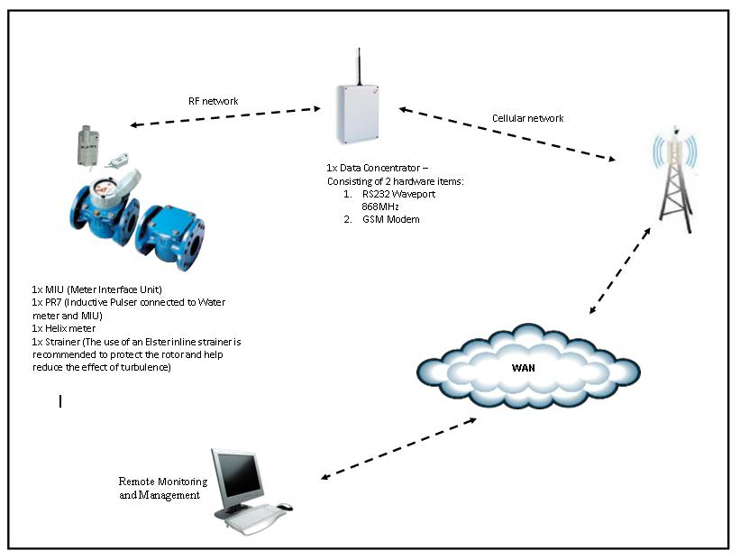
AMI - Description
Mesh network between all meters and Management software
Real time alerts via sms or
email
Full 2-way communication
Full site inspection to be
done before hand
More advanced system but
at higher cost

Slide 10

LoRa Technology with Mobile App
LoRa™ RF technology is a long range and secure, bidirectional communication.
Features:
Low Power WAN
Battery operated
Gateway/Concentrator (star topology)
Ideal for Internet of Things (IoT), metering, security, asset tracking, and machine-to-machine (M2M) applications

Slide 11
LoRa Technology with Mobile App
Two-way communication so unit can be redesigned to control valve function on the fly
Gateways transfer bundled data to Network Servers on GSM networks via GPRS connection
Over the air updates
Compact size
Extended end-device battery life ±5 years
Low cost end-device
Low cost gateway device. Powered by 10W solar panel + 12V 7.2AH battery (1 Gateway servicing 1000+ devices)
No cost per message from end-devices to gateway
Extremely low server monthly service fee per end-device connected
Elster create their own LoRa network, hence any Elster LoRa device (Electricity meters etc.) can connect to same network.

Slide 12
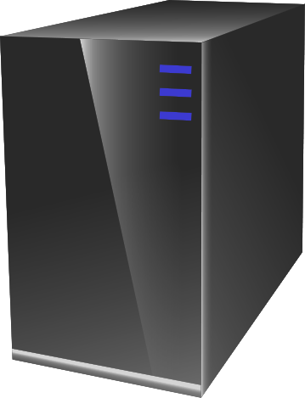

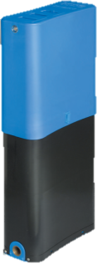

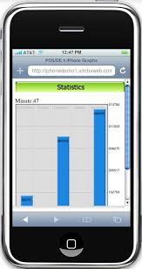
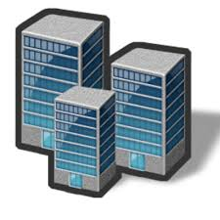
LoRa Technology with Mobile App
Graphical Illustration
Webserver
Meter with Remote reading device
App on Consumer mobile
Municipality

Slide 13
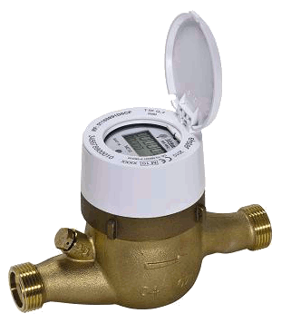
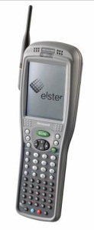
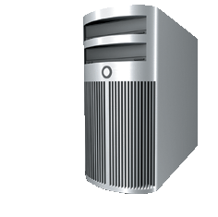

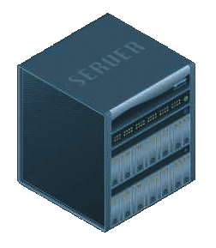
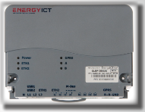
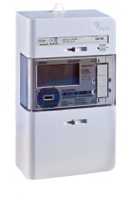
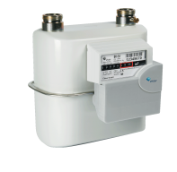
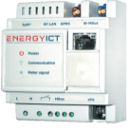

AMR / AMI
Meters
Communication
Head end
Walk-by or Drive-by
ERM2
Fixed Network
GPRS Ethernet
Fixed Network
GPRS Ethernet
ComServerJ

Slide 14
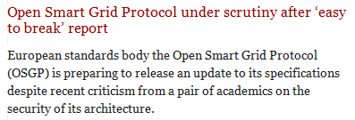


Technology Challenges
Challenges faced with new technologies and solutions:
Many require some source of energy – LCD display, radio, valve, etc.
Battery life expectancy (“up to x years”) – also depends on type and frequency of energy requirement
Communications technology challenges
Type of comms / protocols – cellular, satellite, radio, wifi, internet / ANSI, IEC protocols / fixed wireless, mesh network
Cost effectiveness – Upfront and monthly costs, operational and maintenance costs
Reliability
Comms. Distances (“up to xx m line of sight”)
Software systems
Interoperability – complex system integration, etc.
Data management and analysis
Data security / Privacy – smart meters are becoming too smart (cybersecurity)
Health and safety concerns – EM emissions
Lack of proven savings / Business case is critical

Slide 15
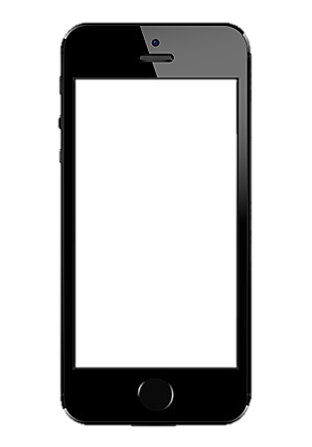
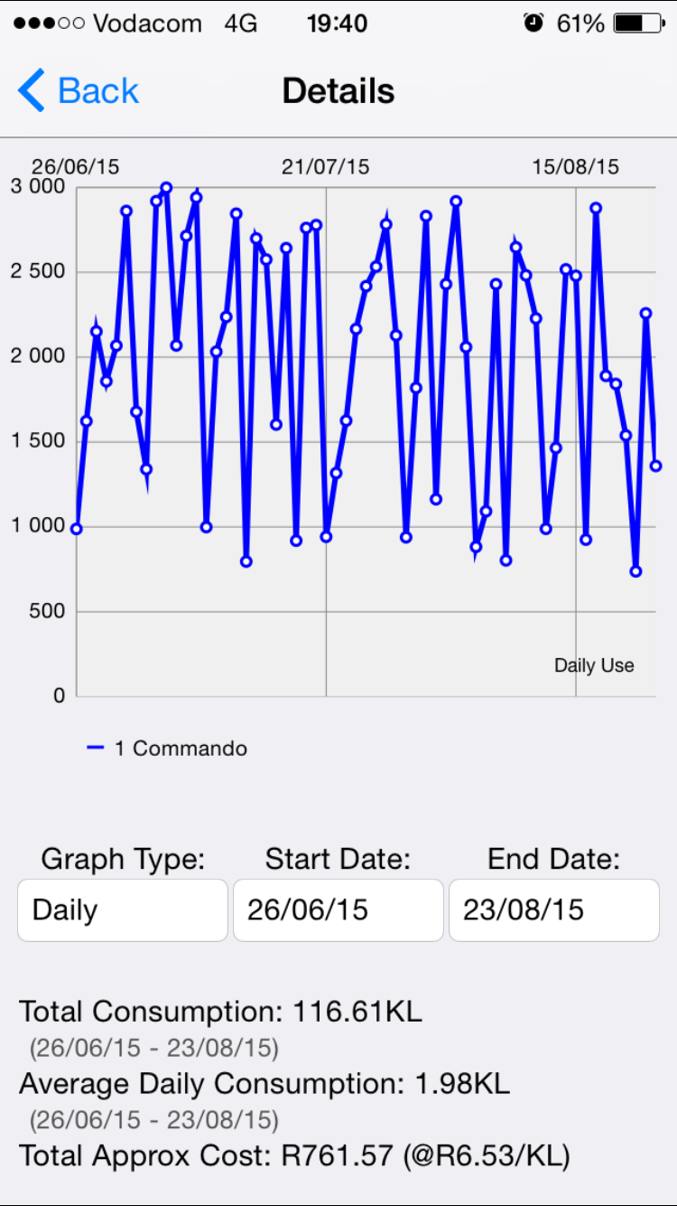
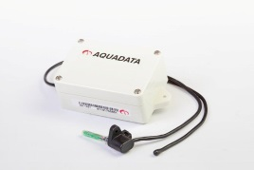
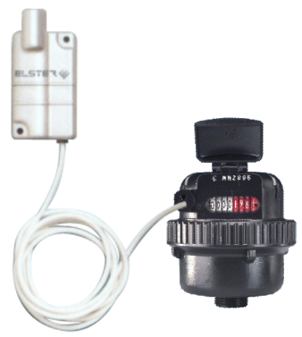
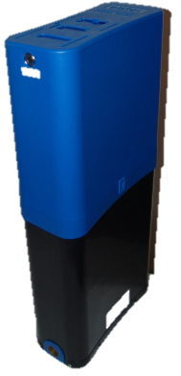
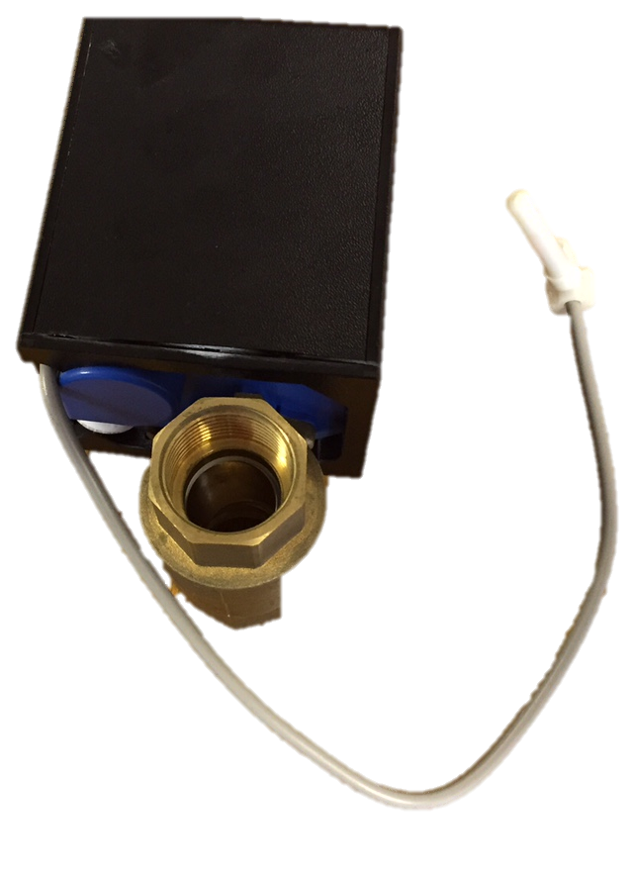
Metering Solutions
2-Way Comms
AMI
LoRa
AMR
There’s no
“One size fits all solution”
1-Way Comms
(from Meter)
Walk-By
(Cellular,Wi-Fi)
Fixed
Prepayment
1-Way Comms
(to Meter)
Dallas Token
STS
Shut-Off Valve
Remote Shut-Off
(Trickle)
WMD
(Upgradeable)

Slide 16


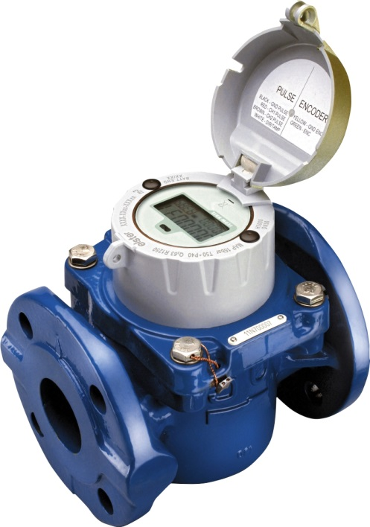

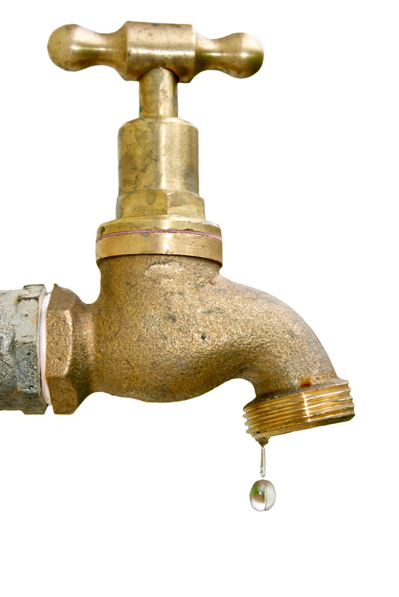
SMART METERING

Slide 17
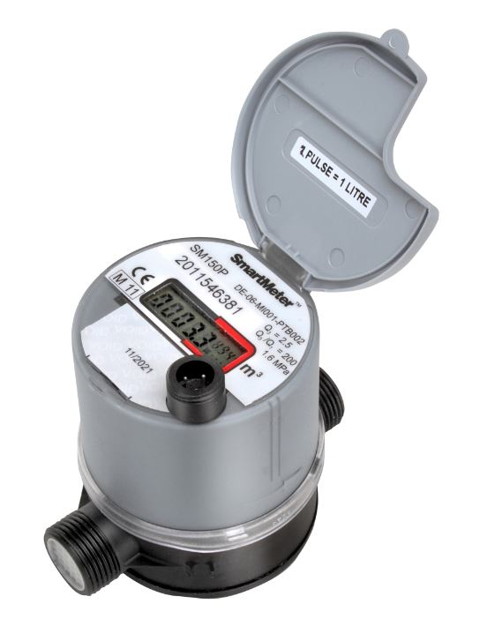
Smart Meters
“SmartMeter” is an Elster Water Trade Mark
Elster Q200 Electronic Meter

Slide 18

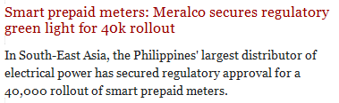
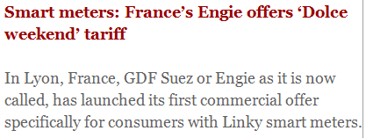
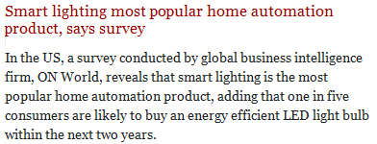
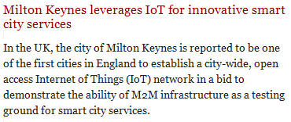
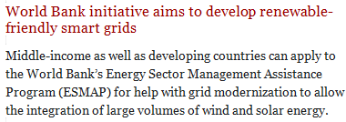
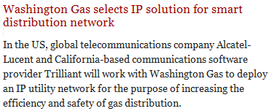

Smart Meters
Everyone wants “Smart” meters
Word “Smart” loosely used as a marketing term (not technical term) to promote a silver bullet “solution to all utility problems”
No clear definition of a “Smart” meter in Water Industry

Slide 19
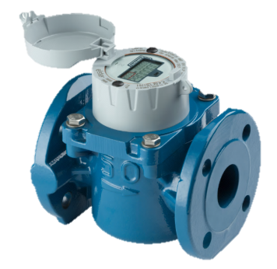
Simplified Definition of Smart Meters
A Smart Meter is a measuring device that, as a minimum requirement, is capable of communicating data to a remote interface at regular intervals
In it’s basic form, smart metering is Automatic Meter Reading (AMR)
Technology is mature and can unlock benefits of data

Slide 20
Benefits of Smart Meters
Benefits to Utility:
Read meter remotely / no access required to properties
Improve meter reading performance – efficiency and accuracy
Tamper detection possible
Proactive leak detection possible
Reduced water pumping through reduced water leakage
Benefits to Consumer:
Provide greater information to customers in relation to their consumption, which enables them to make informed, proactive decisions about their water usage
Provide information to customers that allow them to identify household leakages
Support more frequent and accurate customer billing

Slide 21
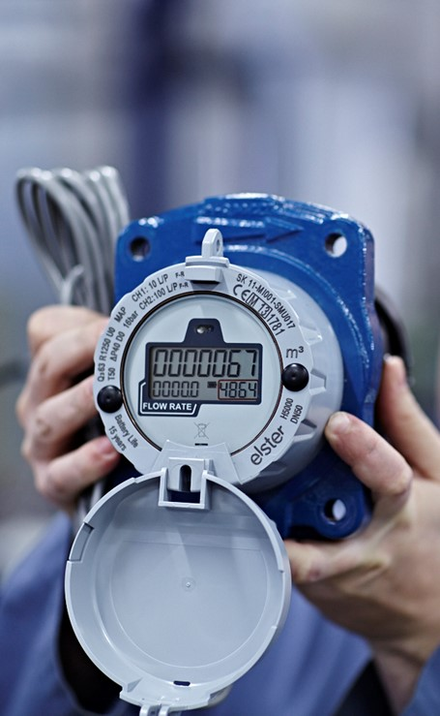
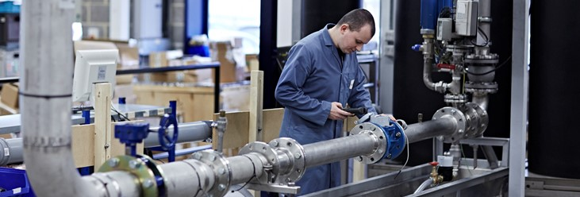
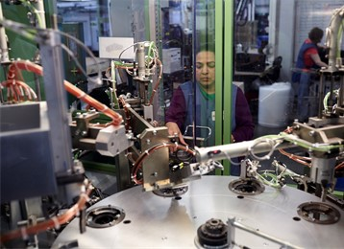
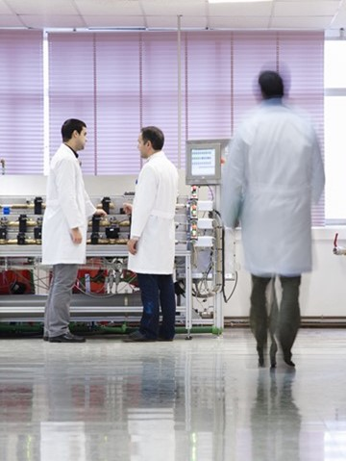

Lean Smart solutions

Slide 22
Why does everyone want Smart Metering?
Smart metering will solve all our problems
It’s our “silver bullet” – leaks, high non-revenue (NRW) water, billing, non-payment, tampering
The investment is worth it if the problems go away
Smart metering is the latest technology in metering

Slide 23
Smart Meter Financial Feasibility
Cost Comparison: Smart Metering Vs Basic Metering *
Product cost only
Smart costs are for basic Walk / Drive-by AMR
Is there a financially feasible solution that can eliminate or minimise the challenges that Utilities face?
“Lean Smart” Metering (Do more with less)
– Smarter solution that excludes the high costs associated with “smart” electronics added to each meter
e.g. 100,000 meters require an additional ZAR 70.7M to upgrade good meters to become basic “smart” meters
– Smart meter projects are not always financially feasible

Slide 24

Lean Smart Metering Solution
Meter Reading and Billing Smart Phone App
Seamless digital meter reading solution that uses affordable smartphones to collect meter information, readings, pictures and GPS co-ordinates for water or electricity connections
Meter Reader or Consumer inputs meter reading into smart phone App, data read by online platform
Automated SMS sent to consumer with:
Opening Reading
Closing Reading
Water / Electricity usage in period
Invoice amount / Bill
Online payment option via separate App (Square Cash)
Replaces paper forms and adds functionality such as time-stamped pictures of the meter reading and GPS co-ordinates
Mobile App ready for implementation!
Square Cash

Slide 25
Lean Smart Metering Solution
Meter Reading and Billing Smart Phone App
Lean Smart Metering can resolve the majority of challenges experienced by utilities:
*
* Assumes that reliable and accurate meter is used

Slide 26
Water is very Cheap
Difference > 1,000 X
> 600 X
* Average consumer cost of water, Jhb rates, 30kl consumption per month

Slide 27

Water is very Cheap

Slide 28
IWA Water Balance
Authorized
Consumption
Billed
Authorized
Consumption
Revenue
Water
Billed Water Exported
Source: IWA Water Balance
Billed Metered Consumption
Billed Unmetered Consumption
Unbilled
Authorized
Consumption
Non-
Revenue
Water
Unbilled Metered Consumption
Unbilled Unmetered Consumption
Water
Losses
Apparent
Losses
Unauthorized Consumption
Customer Metering Inaccuracies
36.8% (1.58bn m³)
R 9,5bn
Systematic Data Handling Error
Real
Losses
Leakage on Mains
±20%
R 5,2bn
Leakage on Service Lines
Leakage & Overflows at Storage

Slide 29

Non-Revenue Water (NRW) - Metros
Metro NRW weighted average = 42.8% (SA = 36.8%)
Metro water usage approx. 40% of SA total
Water scarcity is not the real problem
High NRW provides opportunity
Source: DWS 2015 No Drop Report

Slide 30

High NRW = Opportunity!

Slide 31
Non-Revenue Water (NRW) - Metros
NRW in Tokyo = 3%, Sydney = 12%
High NRW is also opportunity
Minimise water losses:
Pressure management,
Active leakage control,
Asset management,
Speed and quality of repairs
A 10% reduction in system input volume (SIV) and reducing NRW to 25% can generate approximately ZAR 2bn additional income through reduced water purchases and increased water sales
(plus 10% energy savings due to less pump hours)
Source: DWS 2015 No Drop Report

Slide 32

Impact of Leak Run Time
Opportunity
Leak Flow Rate (m³/day)
A
L
R
Leak Run Time (days)
A Awareness Time
L Location Time
R Repair Time
Leak Run Time x Flow Rate = Volume of Water Lost
(A + L + R) [d] x flow rate [m³/d] = Water Lost [m³]

Slide 33
Impact of Leak Run Time
Reduce Awareness Time
Leak Flow Rate (m³/day)
A
Volume of Water Saved
A
L
L
R
R
Leak Run Time (days)
A Awareness Time
L Location Time
R Repair Time
Leak Run Time x Flow Rate = Volume of Water Lost
(A + L + R) [d] x flow rate [m³/d] = Water Lost [m³]

Slide 34
Impact of Leak Run Time
0.2 Days
1.5 Days
0.1 Days
0.2 Days
Leak Flow Rate (m³/day)
A
L
R
Volume of Water Saved
A
R
L
Volume of Water Saved
R
Leak Run Time (days)
(A + L + R) [d] x flow rate [m³/d] = Water Lost [m³]
(1.5 + 0.1 + 0.2) [d] x 240 [m³/d] = 432 [m³]
(0.2 + 0.1 + 0.2) [d] x 240 [m³/d] = 120 [m³]
Volume of Water Saved = 432 - 120 = 312 [m³]
Value of Water Saved = 312 [m³] x 32.27 [R] = R 10 068 * At Jhb. rates 2016/7
Value of Water Saved x 500 Leaks = 500 x R 10 068 = R 5,034M

Slide 35
War on Leaks
President Jacob Zuma announced at the State of the Nation
Address (SONA) 2015:
“Let me Honourable Speaker and Chairperson urge all in the country to conserve water. Every drop counts. The country loses seven billion rand a year to water losses. To mitigate this challenge, Government through the Department of Water and Sanitation will train fifteen thousand artisans and or plumbers who will fix leaking taps in their local communities.”
Phase 1 - September 2015 with 3000 trainees - plumbing, instrumentation, fitter and turner, electrical, welding and water agents. Workplace training commenced in May 2016.
Phase 2 - 7000 trainees as of the 1st of July 2016.

Slide 36

Lean Smart Management Solution
Water Leakage Reporting via Smart Phone
High volume of water leakage (NRW = 36.8%)
– also opportunity.
How can leakage be reported (Awareness Time) as soon as possible to minimise water lost?
Millions of South Africans carry with them a sophisticated tracking device – cellphone.
Solution - Water Management App.
Allow anyone to actively report water issues via the App e.g. water leaks, water quality, pressure problems, infrastructure theft, etc. instantly and conveniently – from their phones, from wherever they may be.
To report leak, open App, one tap – will allow for reporting of leak (or other water issue) and pin point position utilising GPS co-ordinates.

Slide 37

Lean Smart Management Solution
Incident Reporting Smart Phone App
The cellular App:
Allows the Utility to dynamically respond to the issue logged (quickly respond to leaks and reduce non-revenue water), and
Plot and record water issues against geographic locations.
This framework could tightly integrate core operations (possibly including War on Leaks Teams) – issuing tasks to repair teams and monitoring their progress in real time, leading to increased efficiencies and more automated workflows.
Convenient, easy to use, cost–effective tool to reduce water wastage.
Will also raise awareness of water use.
Mobile App can be complete within 4 weeks!

Slide 38
Smart Metering – Conclusions
Do smart metering projects really have a reasonable and feasible financial payback?
It’s been financially a very bumpy ride for many smart metering projects
There is “no one size fits all” solution in metering or Smart metering:
Focus on selecting the right investment
Use tools and technology to do more with less (“Lean Smart Solutions”)

Slide 39


Conclusion
There’s no “Once size fits all” solution in metering
A Reliable and Accurate water meter is the source which enables:
Informed and optimised data management analysis and decisions e.g. water balance, leak detection, water losses, non-revenue water, logging
Accurate billing and enhanced revenue collection
Lean Smart metering solutions can provide a more cost effective and efficient solution to solving many challenges

Slide 40



Mark Capper
mark.capper@honeywell.com
+27-21-511-8465/6
www.Honeywell.com
www.elster.com
Thank you

